Slide 1
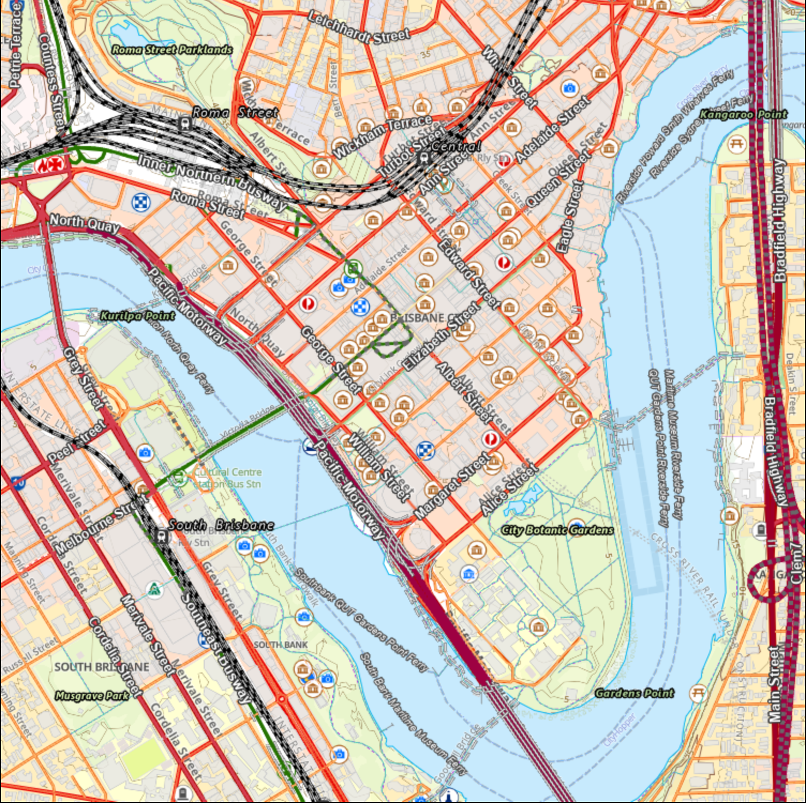
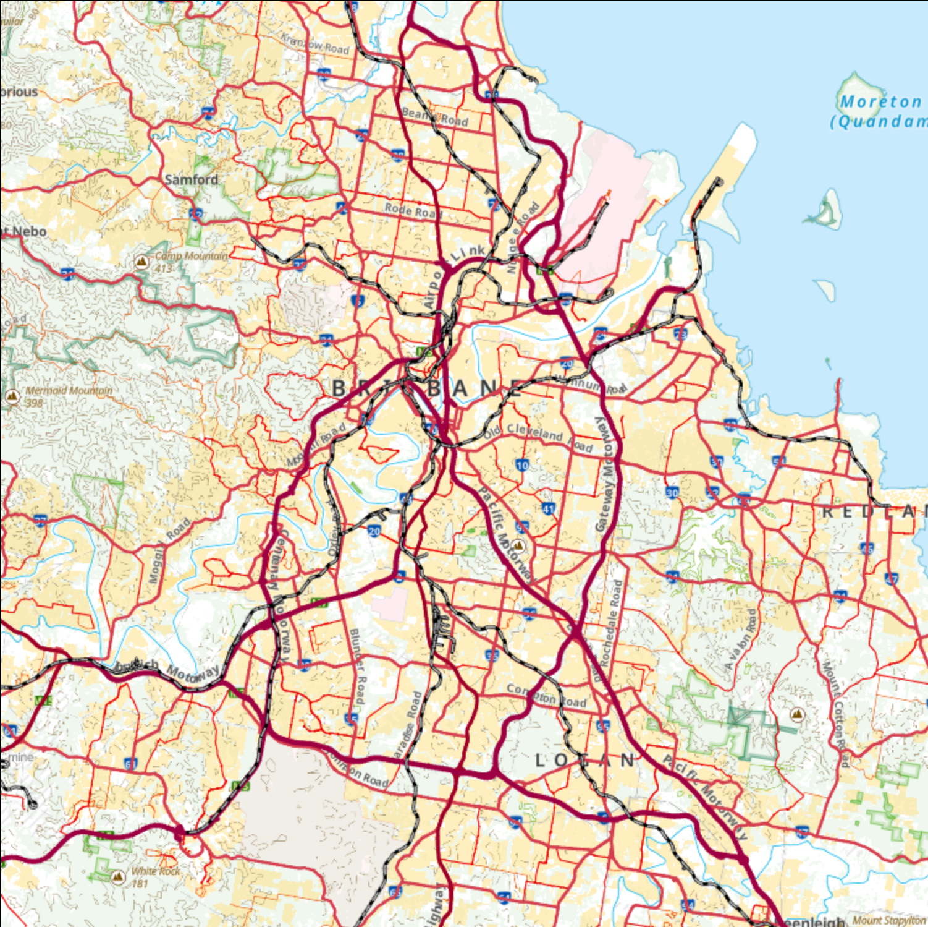
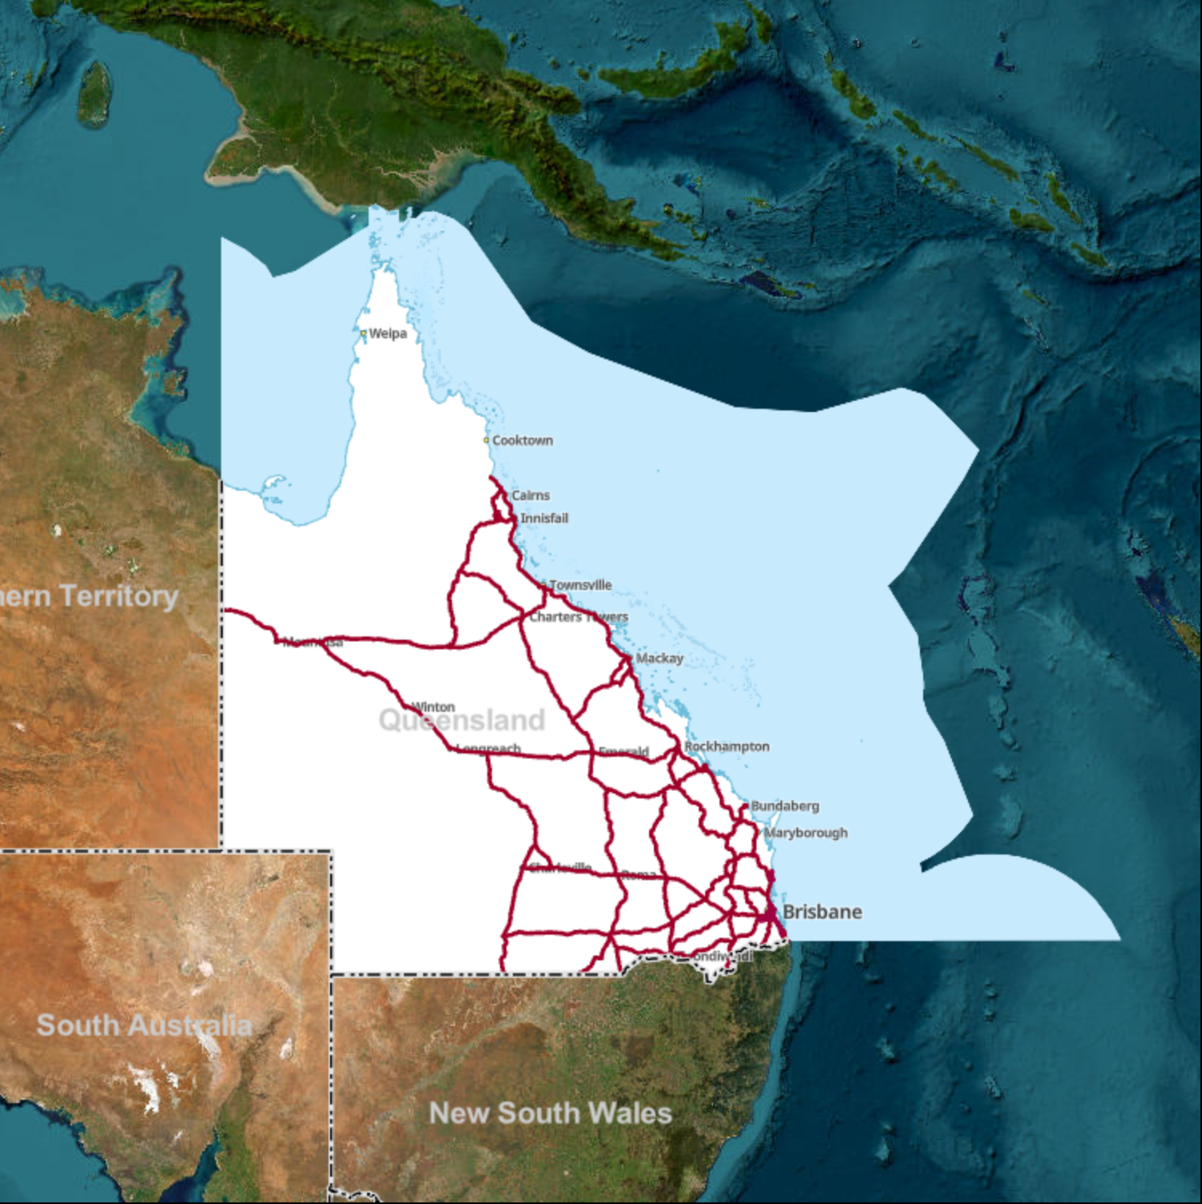
Introduction to QGIS for Transport Applications

Slide 2
Content
Navigating QGIS
QGIS Project
Create a QGIS project and load Data/Map
Data and map information
Attribute Table and its functionality
Selection, filtering, and subsetting data
Load spatial point data (Annual Average Daily Traffic data)
Using selection tool
Finding intersections
Add new fields to the intersection attribute table and populating them with relevant information

Slide 3
What can you do with QGIS?
Analysis
Processing toolbox
Graphical Modeler
Python Console
Network Analysis (via plugins such as QNEAT3)
Raster and Image Analysis (via GDAL, GRASS, SAGA)
Visualization
Multiple layouts
Transparency
3D cartography
Map Series
Animation

Slide 4
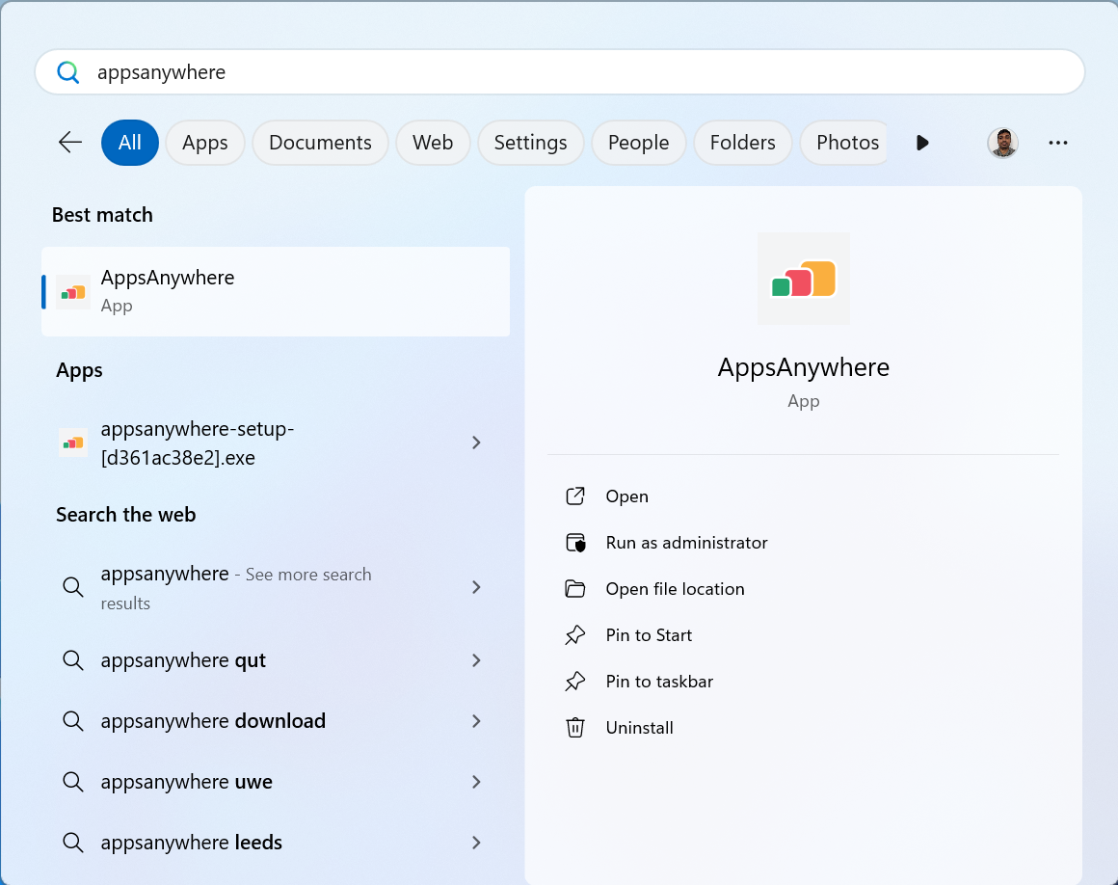
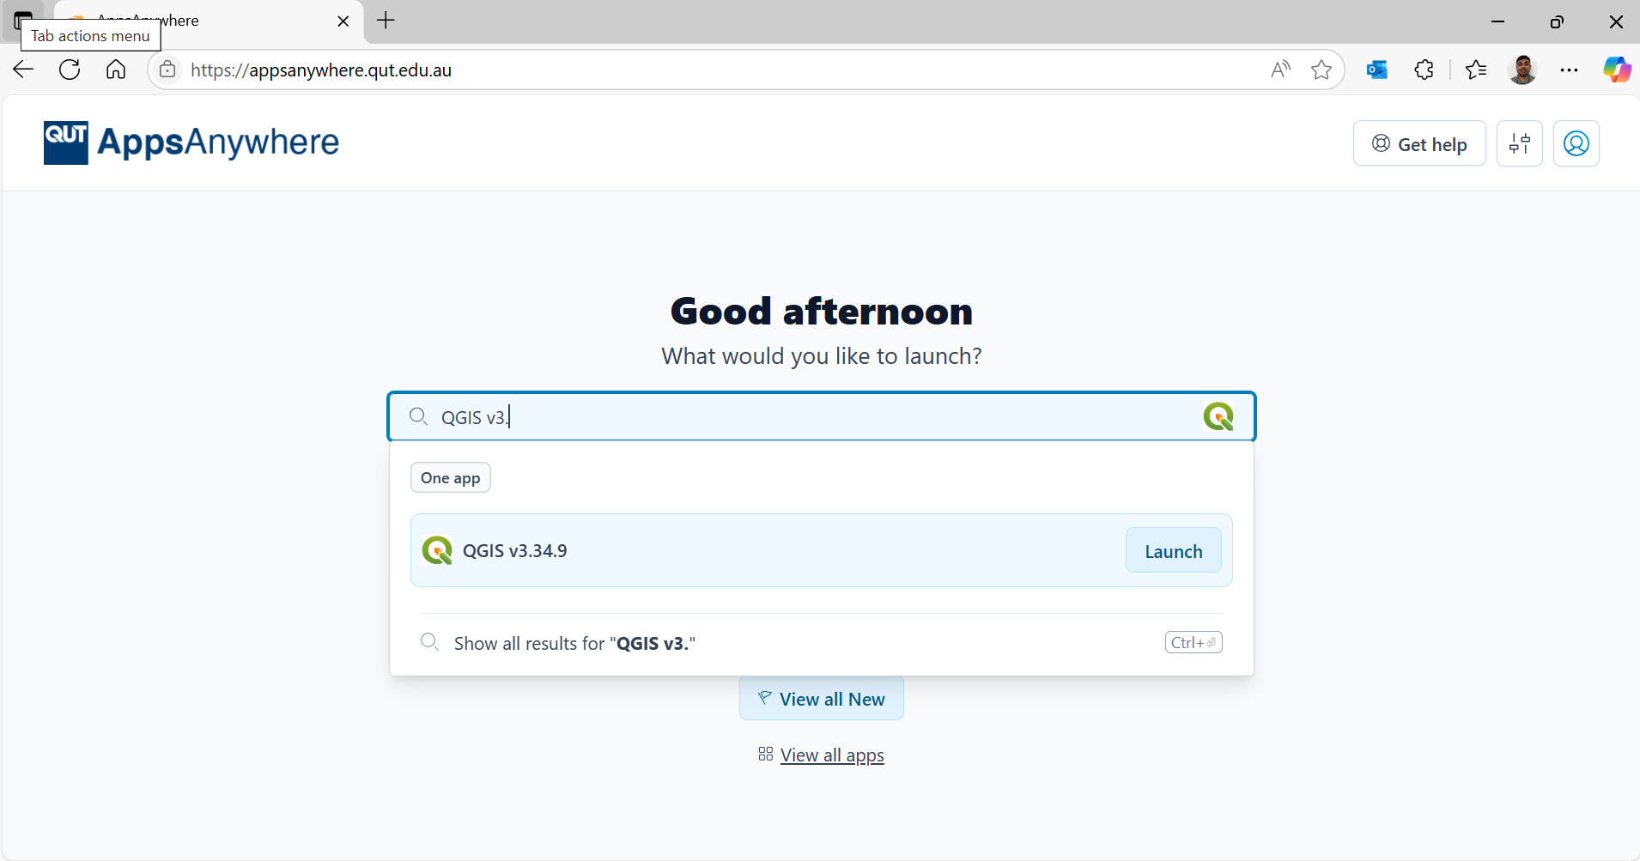
How to access QGIS in QUT labs ?

Slide 5
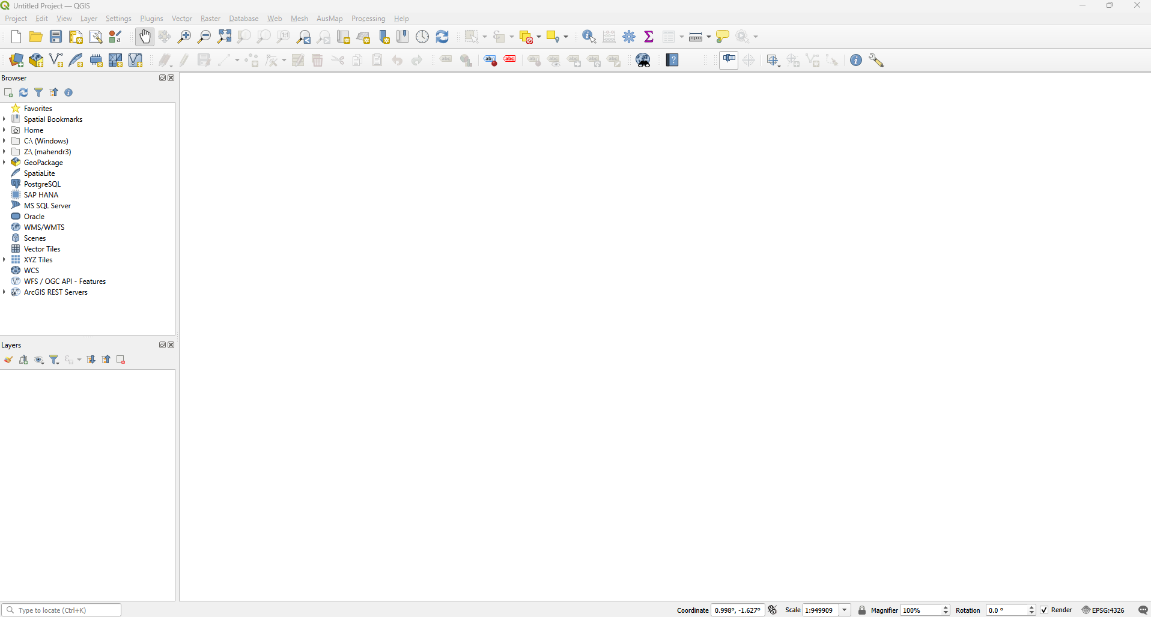
Navigating QGIS
Tool bar
Contents Pane
User Interface
Layer Pane

Slide 6
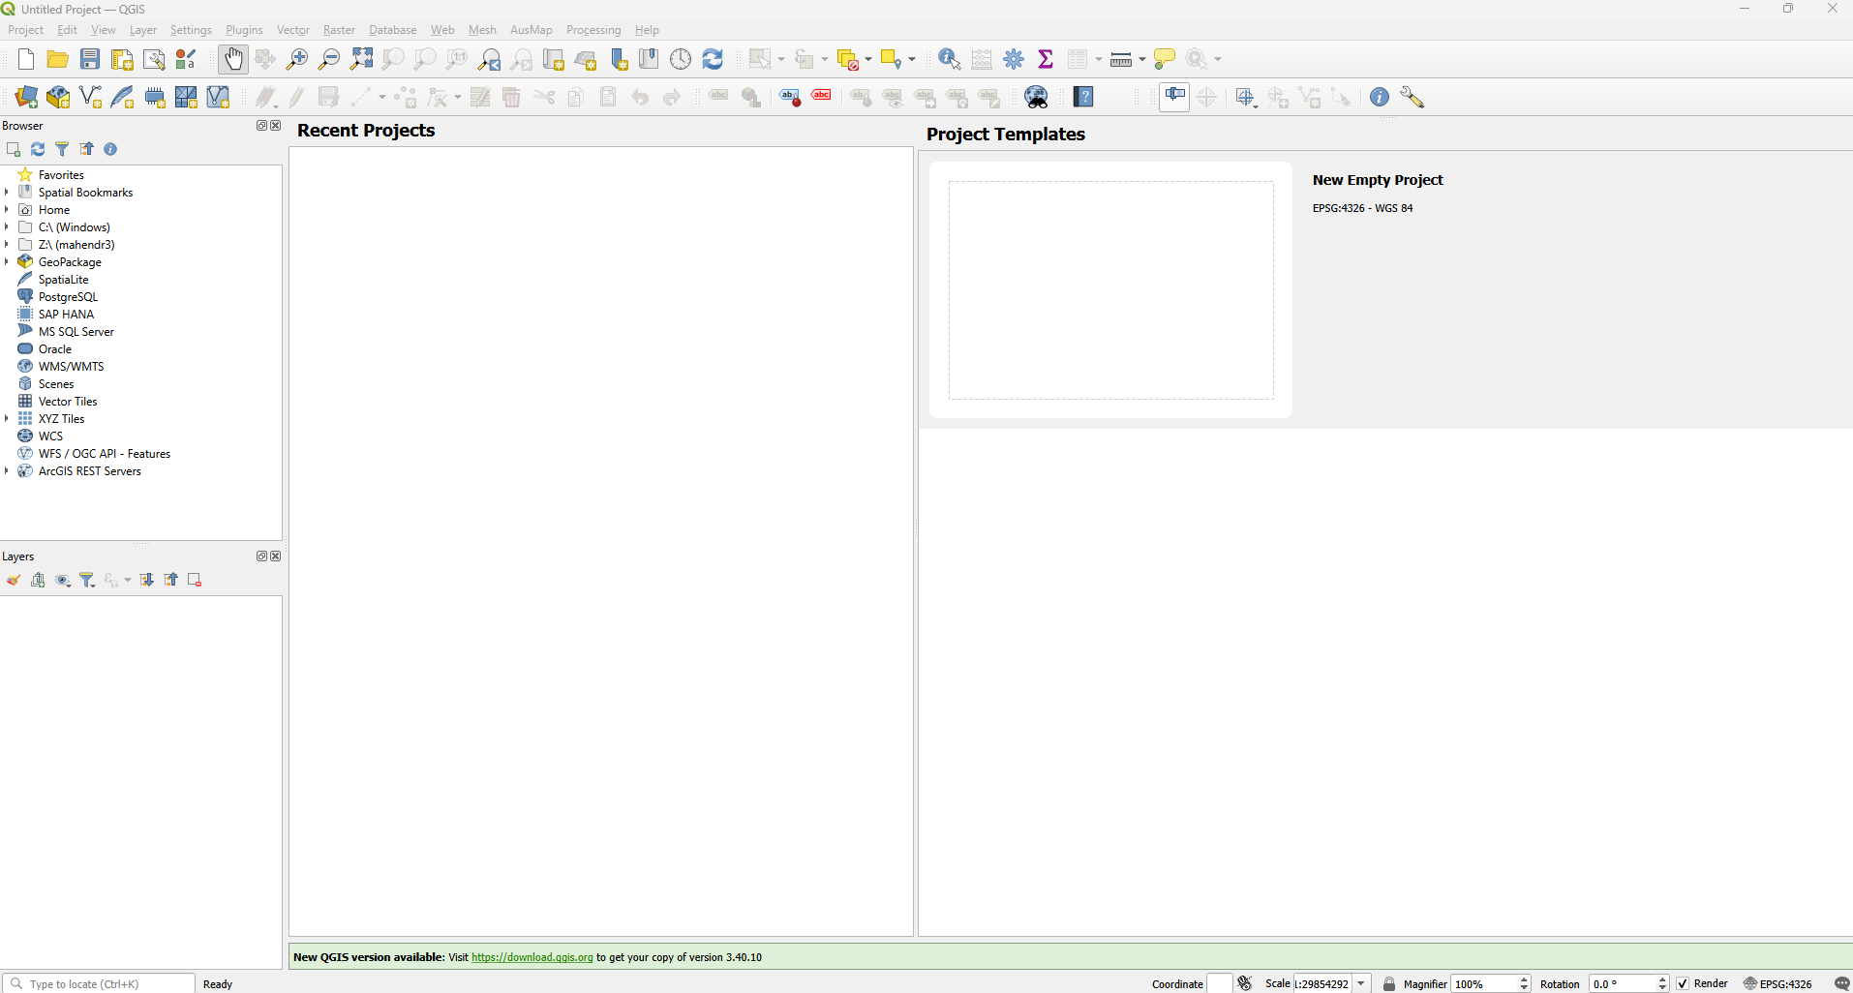
QGIS Project

Slide 7
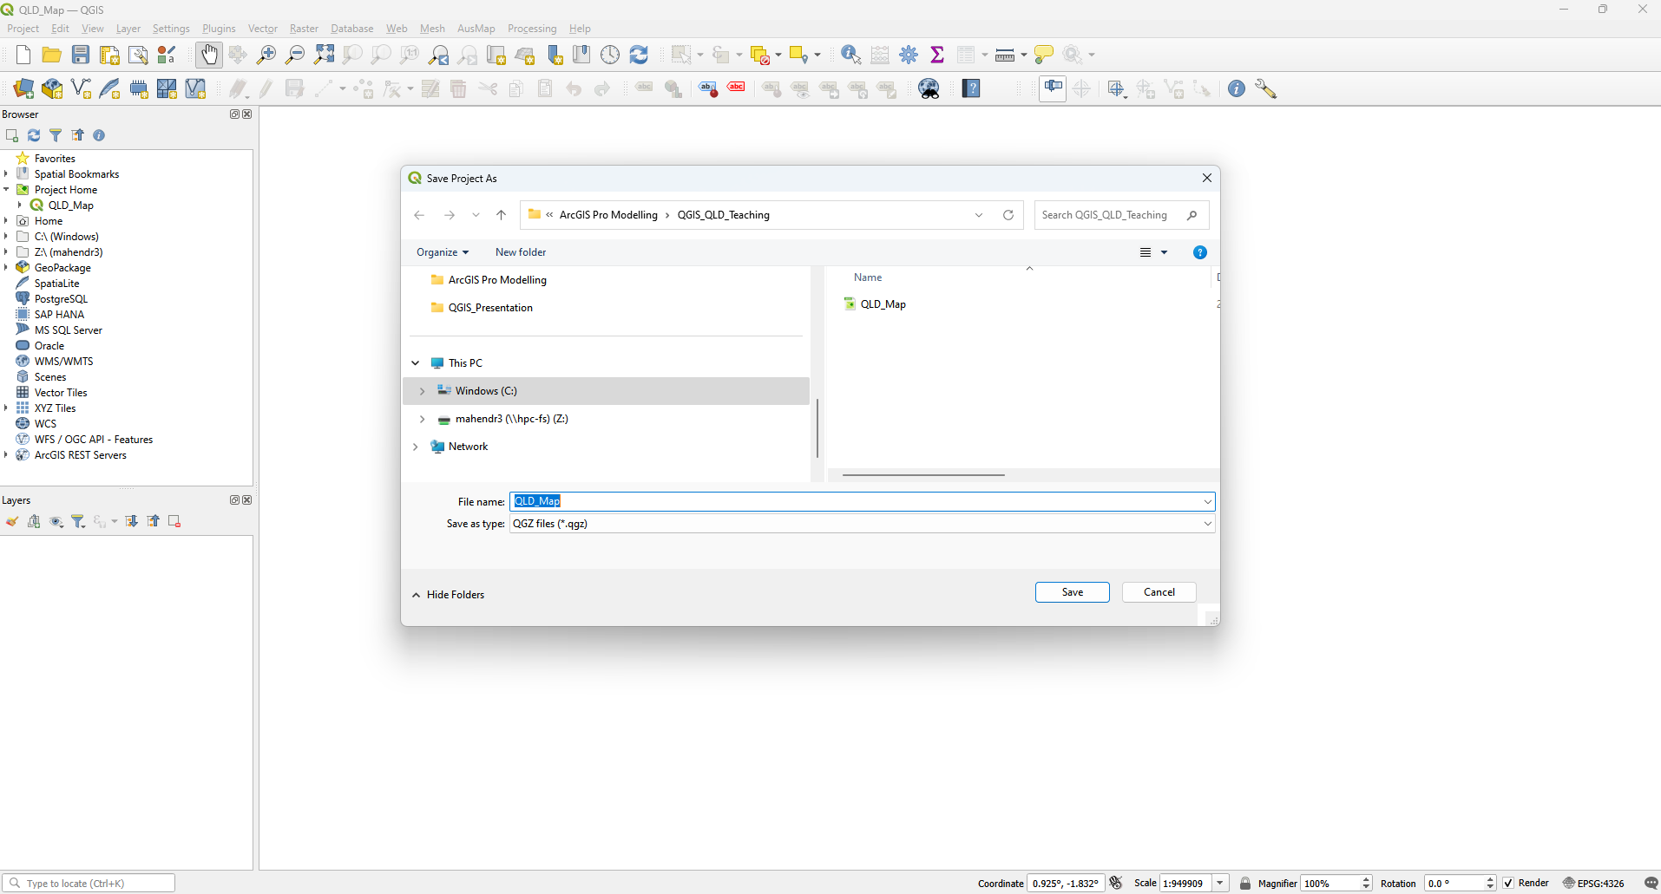
New QGIS Project Save button > “Select a Location” > Create a folder > Enter the name “QLD_Map”

Slide 8
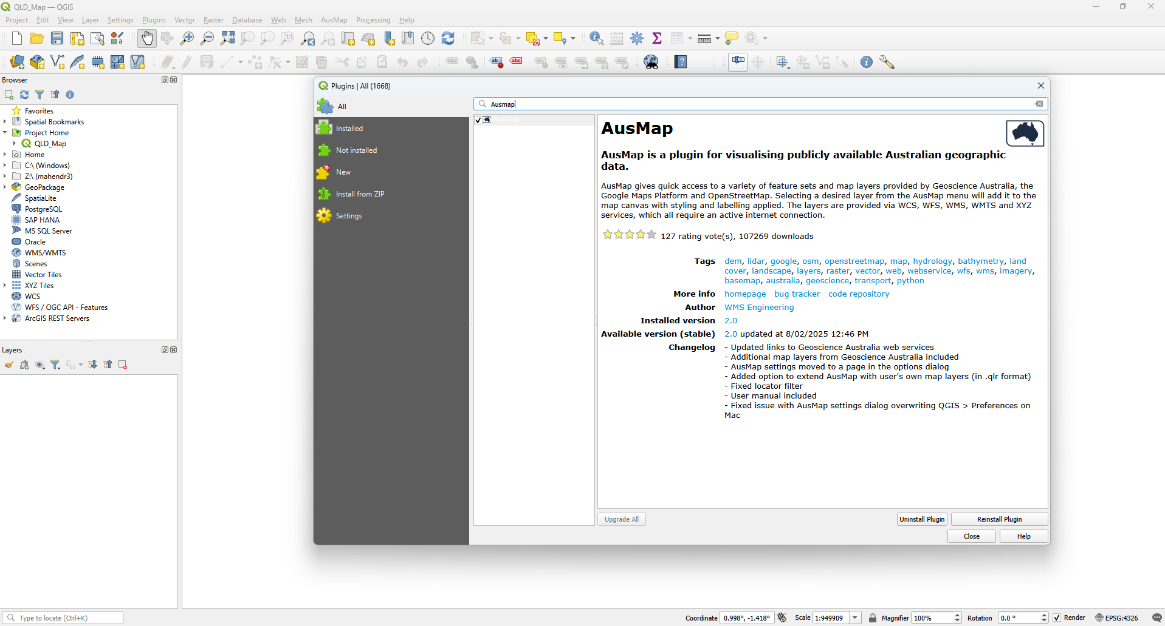
QGIS Project

Slide 9
QGIS Project

Slide 10
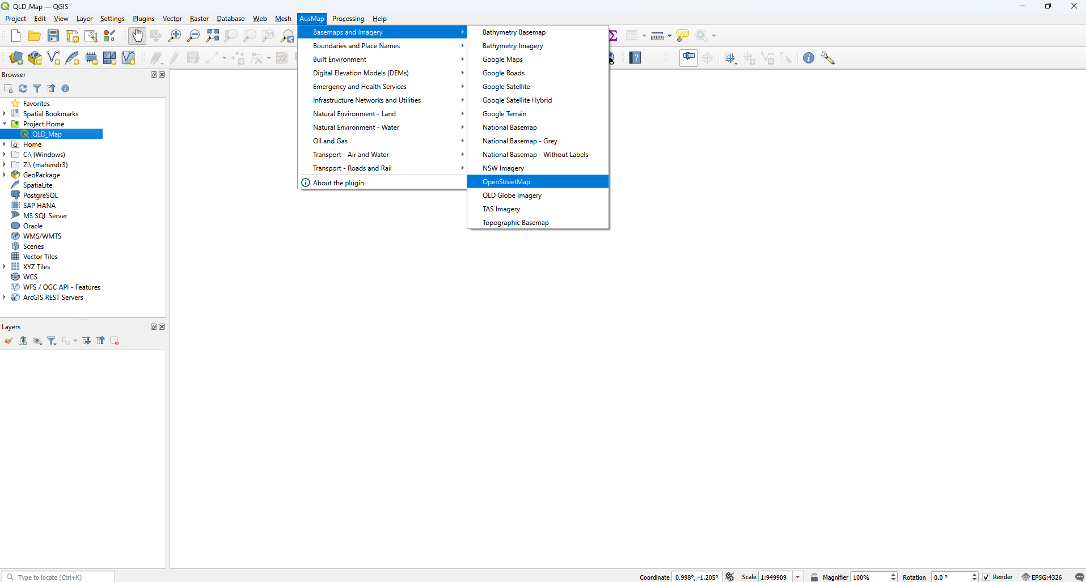
QGIS Project

Slide 11
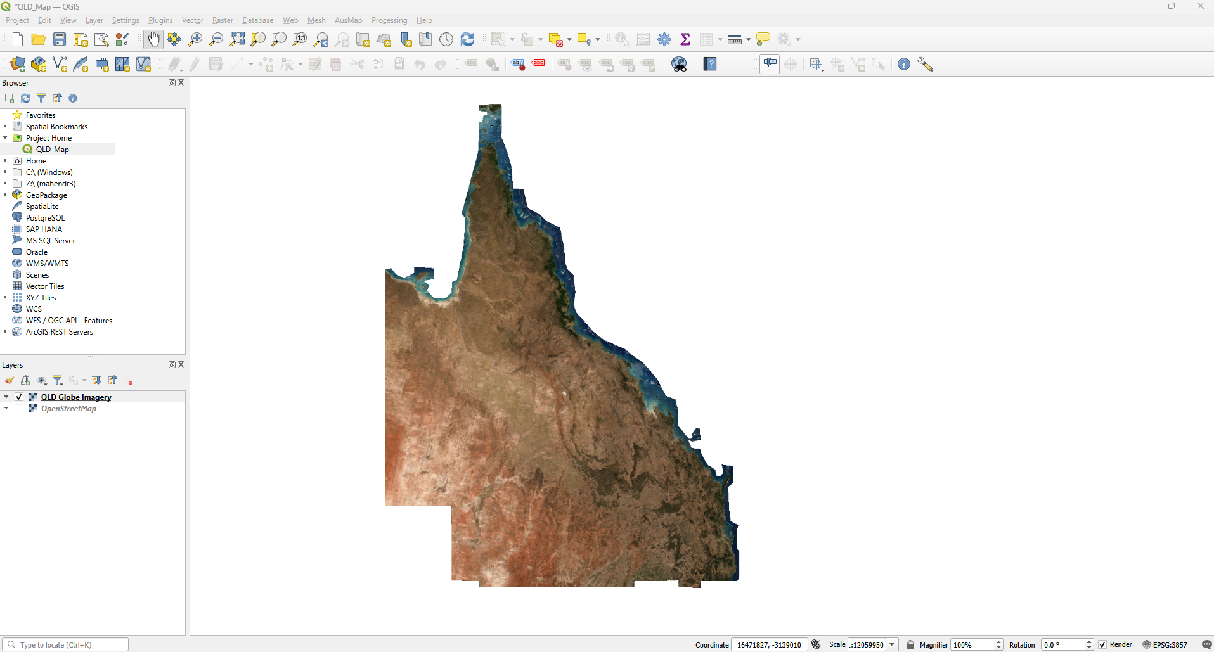
QGIS Project (Load the QLD Globe Imagery)

Slide 12
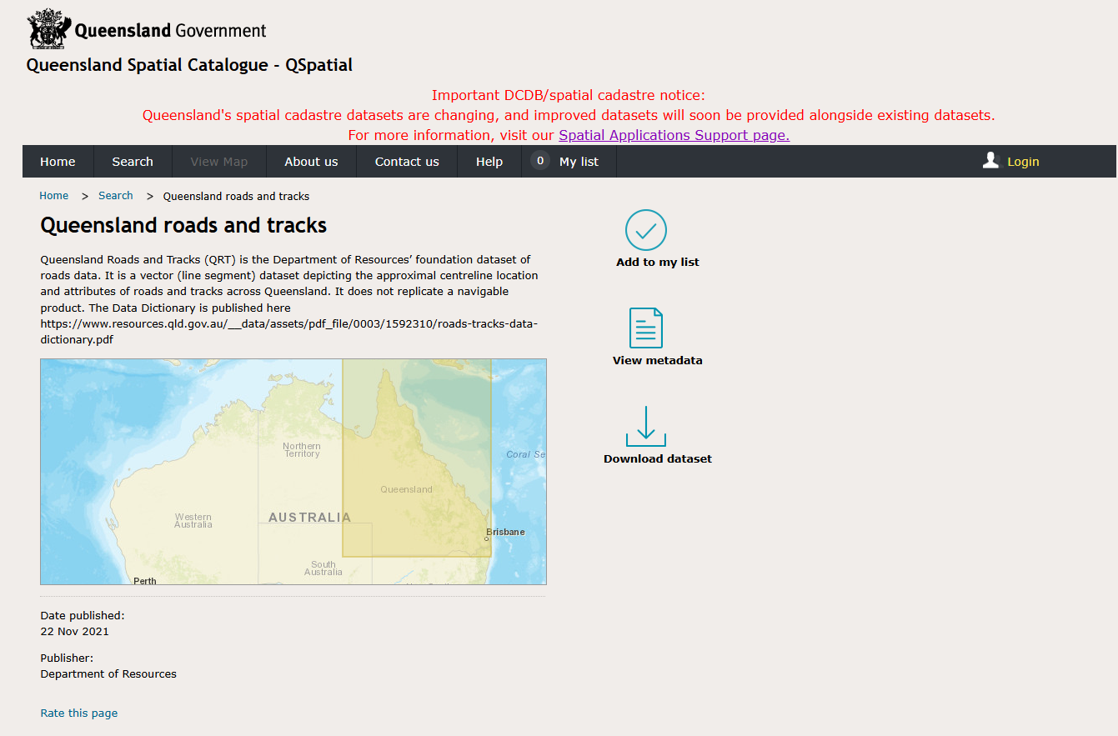
QLD roads and tracks data

Slide 13
QLD roads and tracks data
Data is available in the OneDrive folder

Slide 14
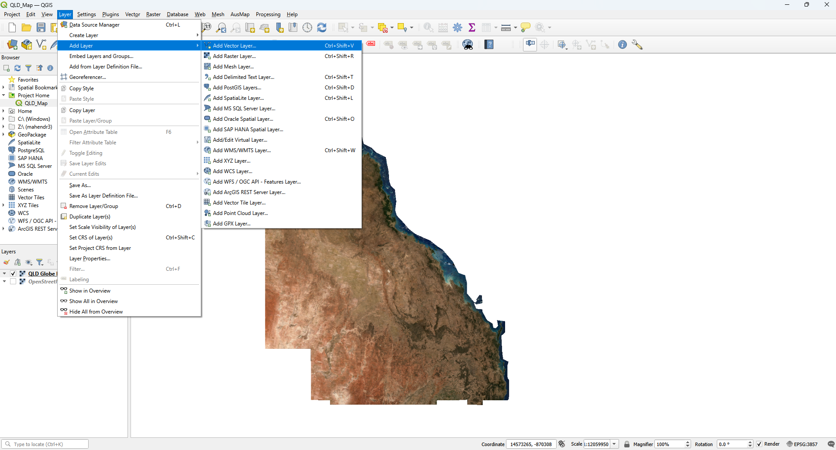
Loading data Layer > Add Layer > Vector Layer

Slide 15
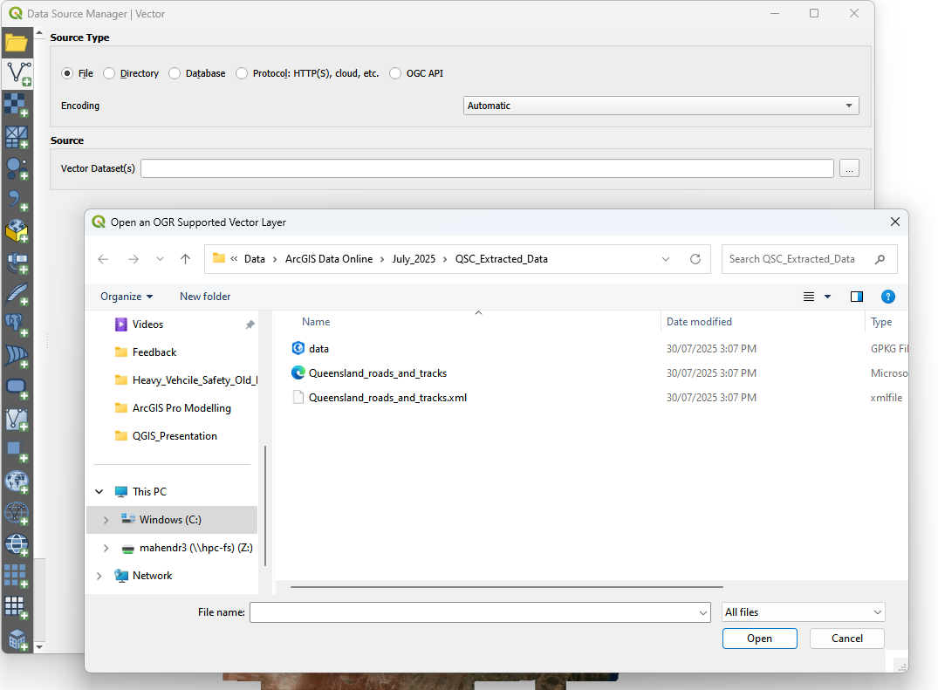
Loading data Layer > Add Layer > Vector Layer

Slide 16
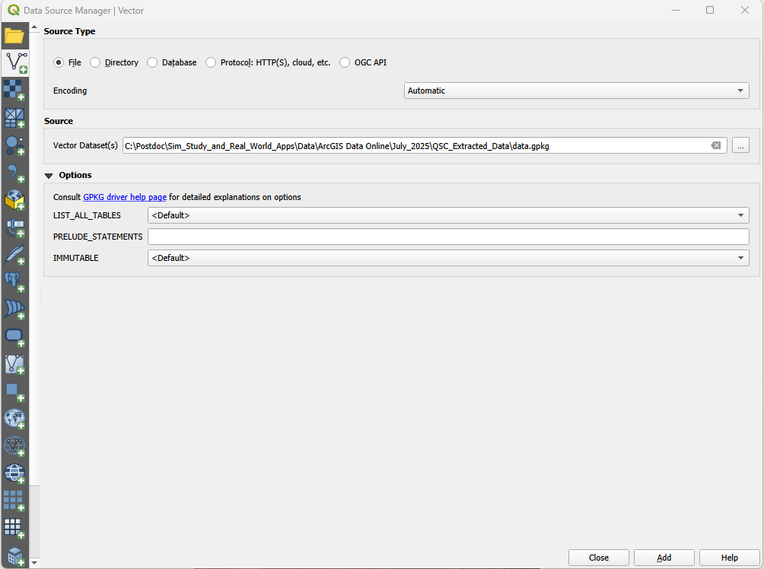
Loading data Layer > Add Layer > Vector Layer

Slide 17
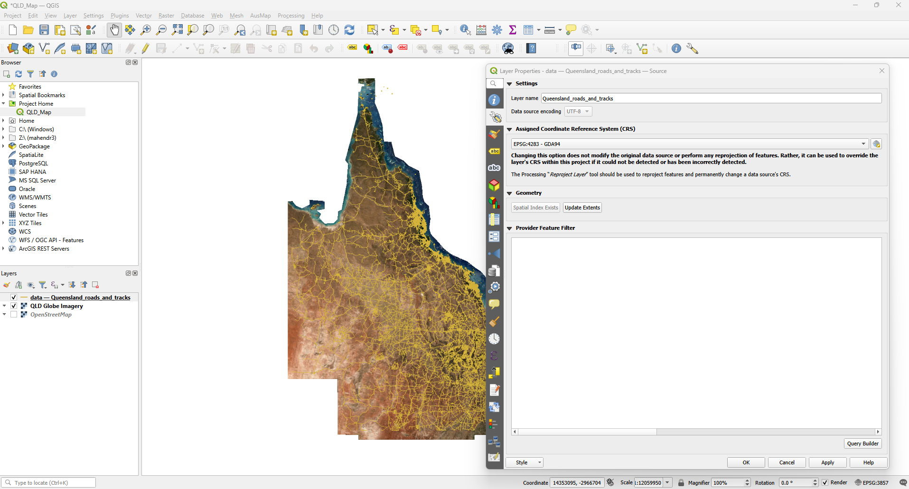
Loaded Qld roads and tracks data Right click on layer > select properties

Slide 18
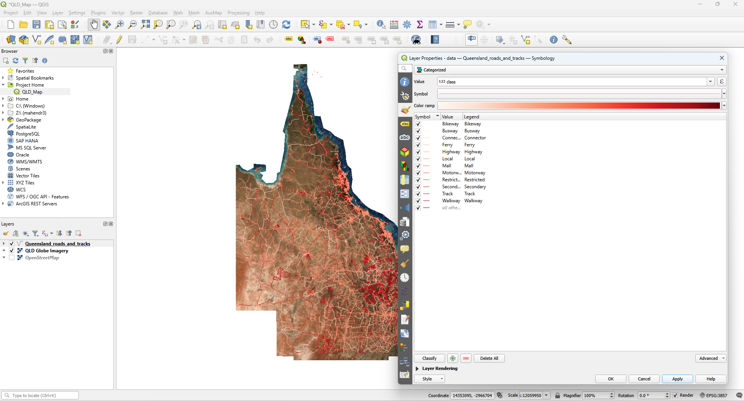
Loaded Qld roads and tracks data Right click on layer > select properties

Slide 19
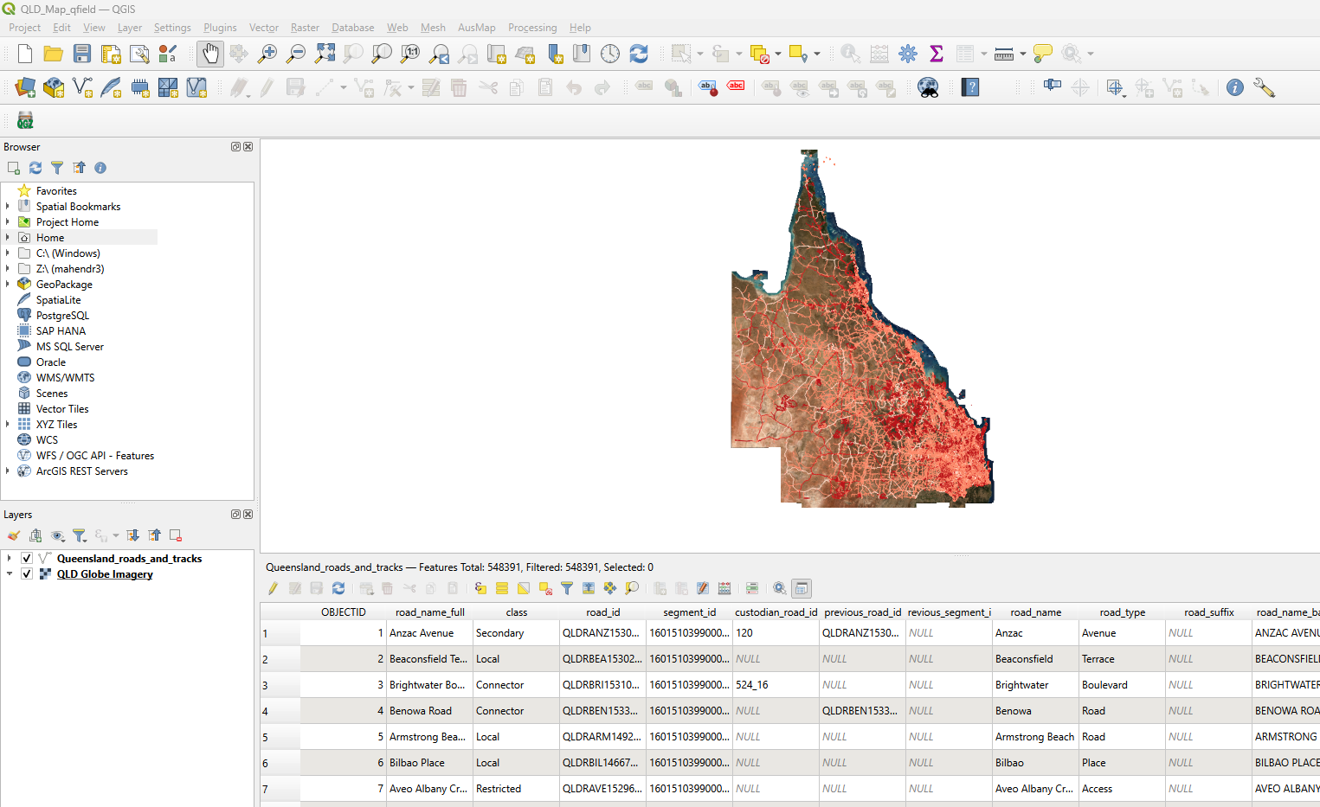
Attribute table for Qld roads and tracks data Right click on layer > Attribute Table

Slide 20
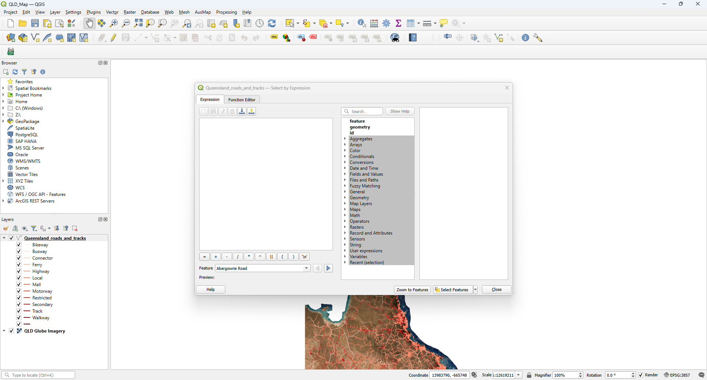
Selection/Filter/Subsetting features Tool bar > Select Features by Expression

Slide 21
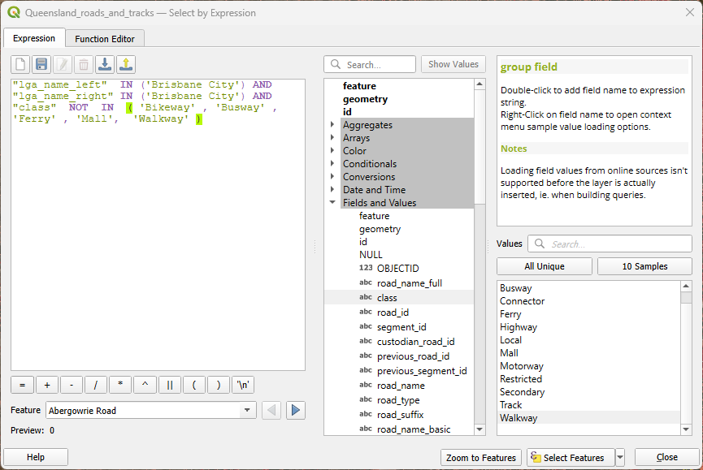
Selection and Filtering criteria
Selection Criteria
Local government authority is only Brisbane city
“lga_name_left” IN (‘Brisbane City’)
“lga_name_right” IN (‘Brisbane City’)
Class of vehicles
“class” NOT IN (‘Bikeway’, ‘Walkway’, ‘Busway’, ‘Mall’, ‘Ferry’)

Slide 22
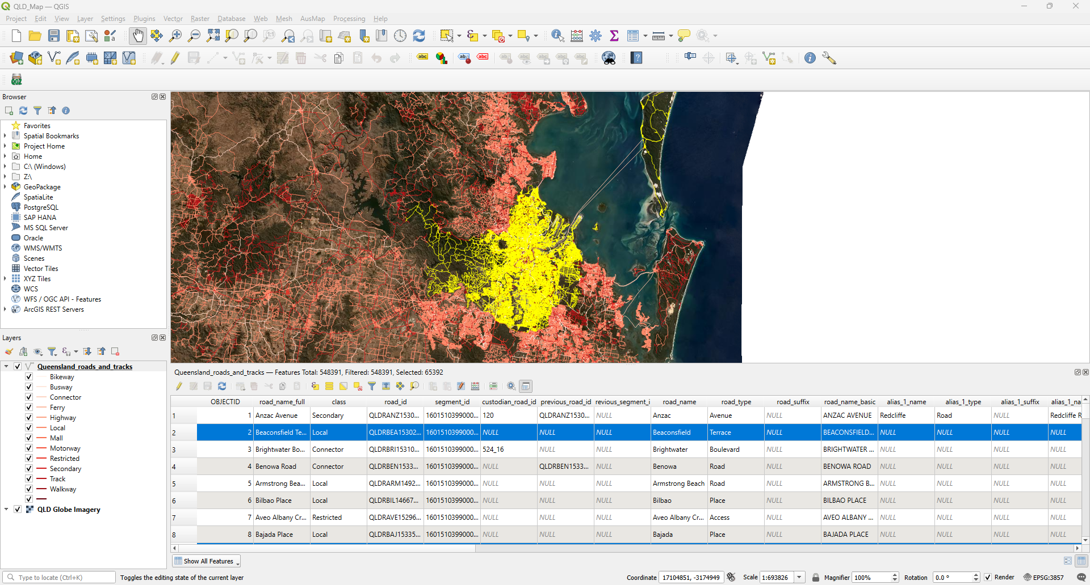
Selected links from the layer Selected features are highlighted in blue in the attribute table and yellow in the map

Slide 23
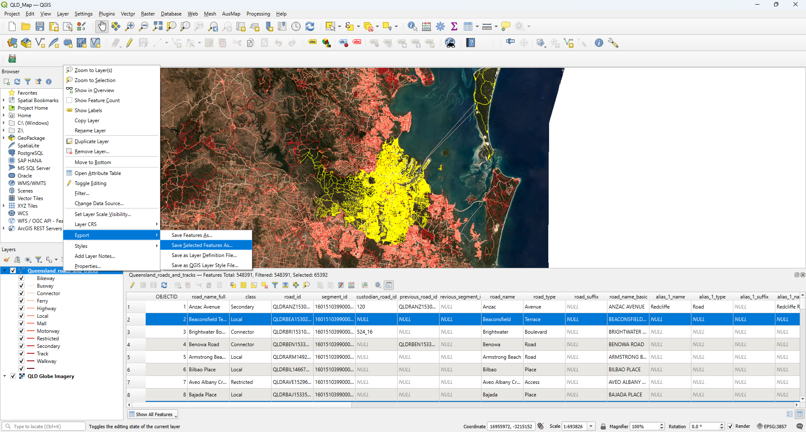
Save selected features as a layer Right click on layer after selection > Export > Make Layer from Selected Features

Slide 24
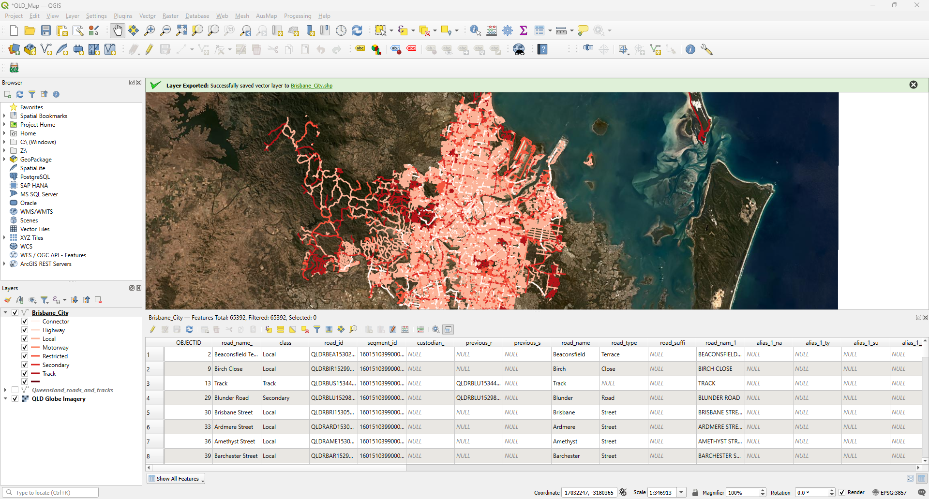
New layer

Slide 25
Task 1 : Attribute filtering and separate layer
From the Queensland_roads_and_tracks map, filter the data based on the following attributes:
“lga_name_left” and “lga_name_right” is “Gold Coast City”
“road_owner” is “TMR”
Save this selection as a separate layer named “Goldcoast_City”.

Slide 26
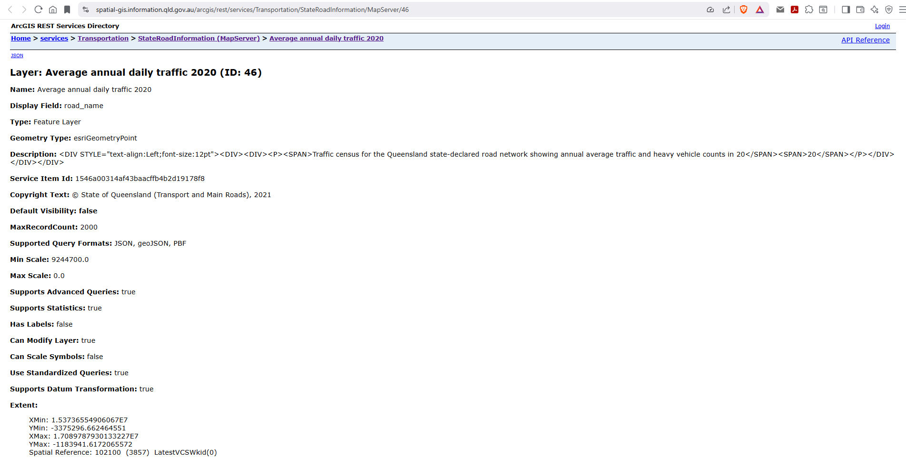
Loading Spatial Point Data (https://spatial-gis.information.qld.gov.au/arcgis/rest/services/Transportation/StateRoadInformation/MapServer/46) Paste the copied link into the path field

Slide 27
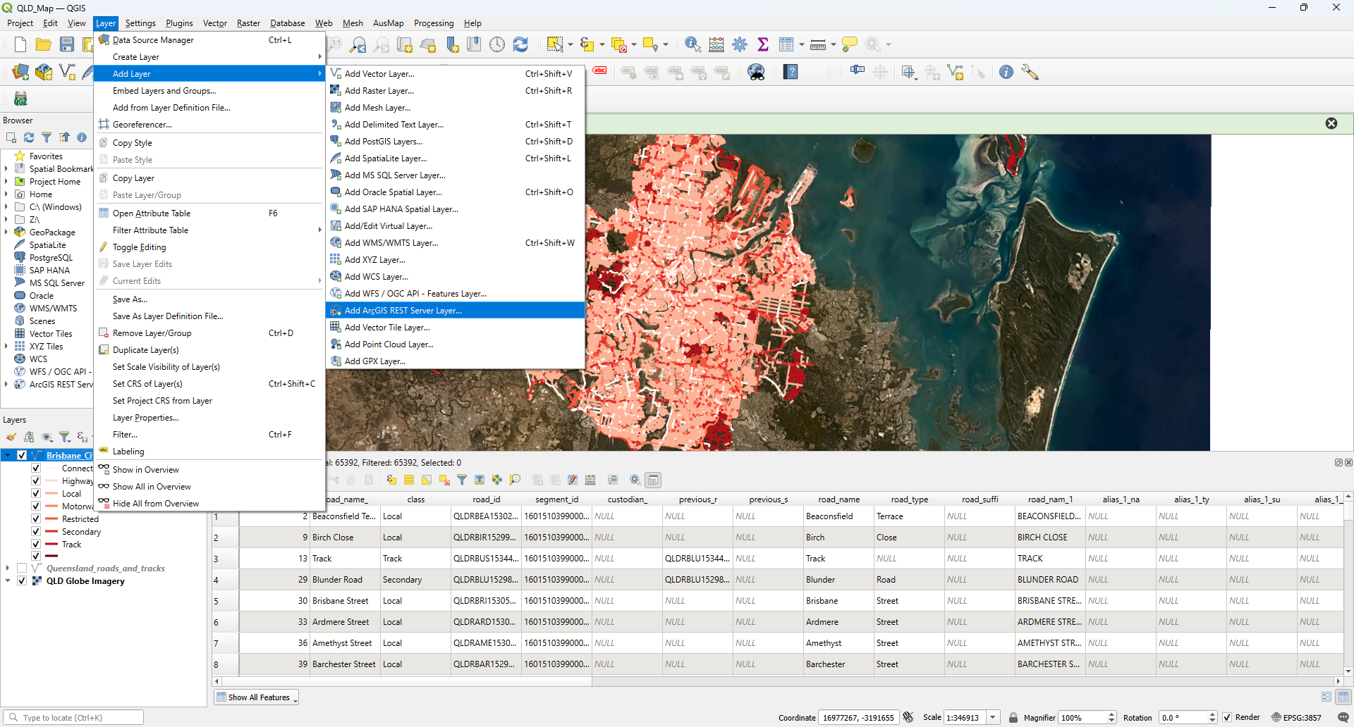
Loading spatial point data from path Add Layer > Add ArcGIS REST Server Layer

Slide 28
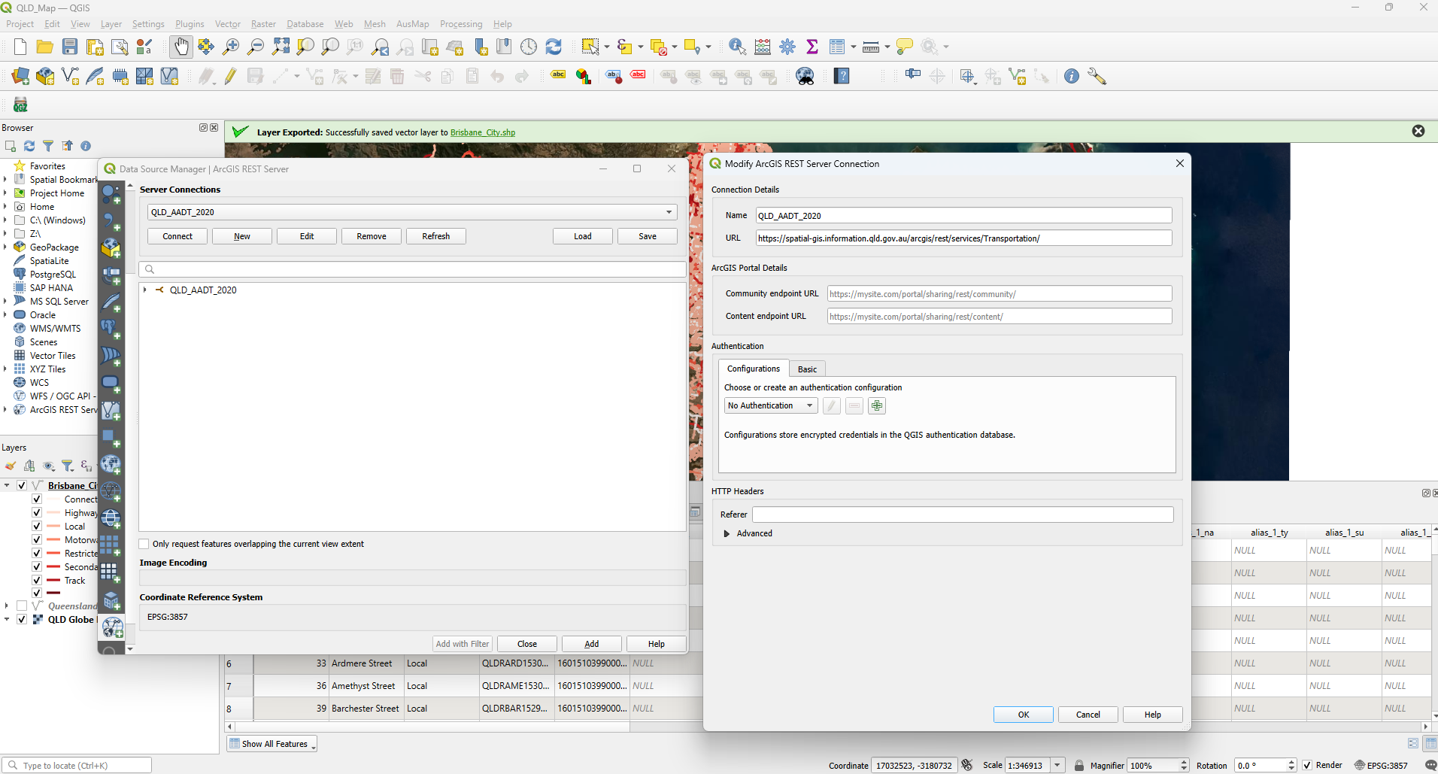
Loading spatial point data from path Copy the html link for the data > paste the link under the Path

Slide 29
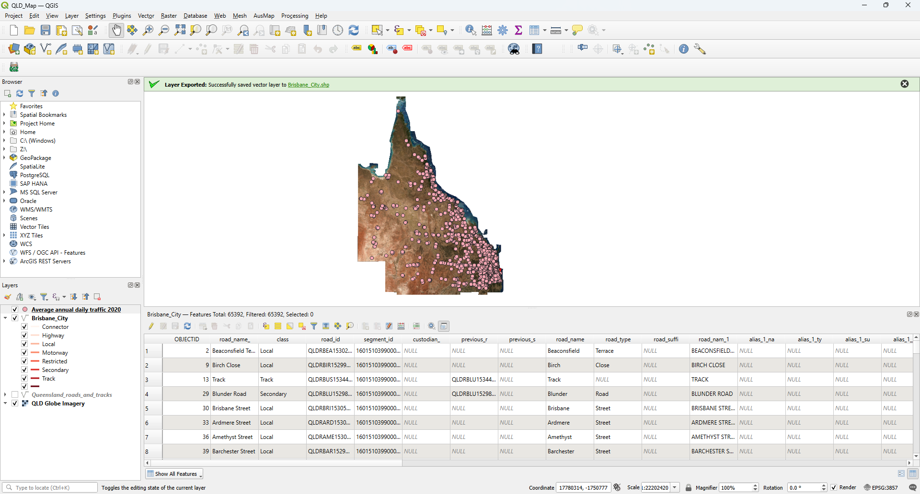
Loaded spatial point data New layer named Average annual daily traffic 2020 in the contents pane

Slide 30
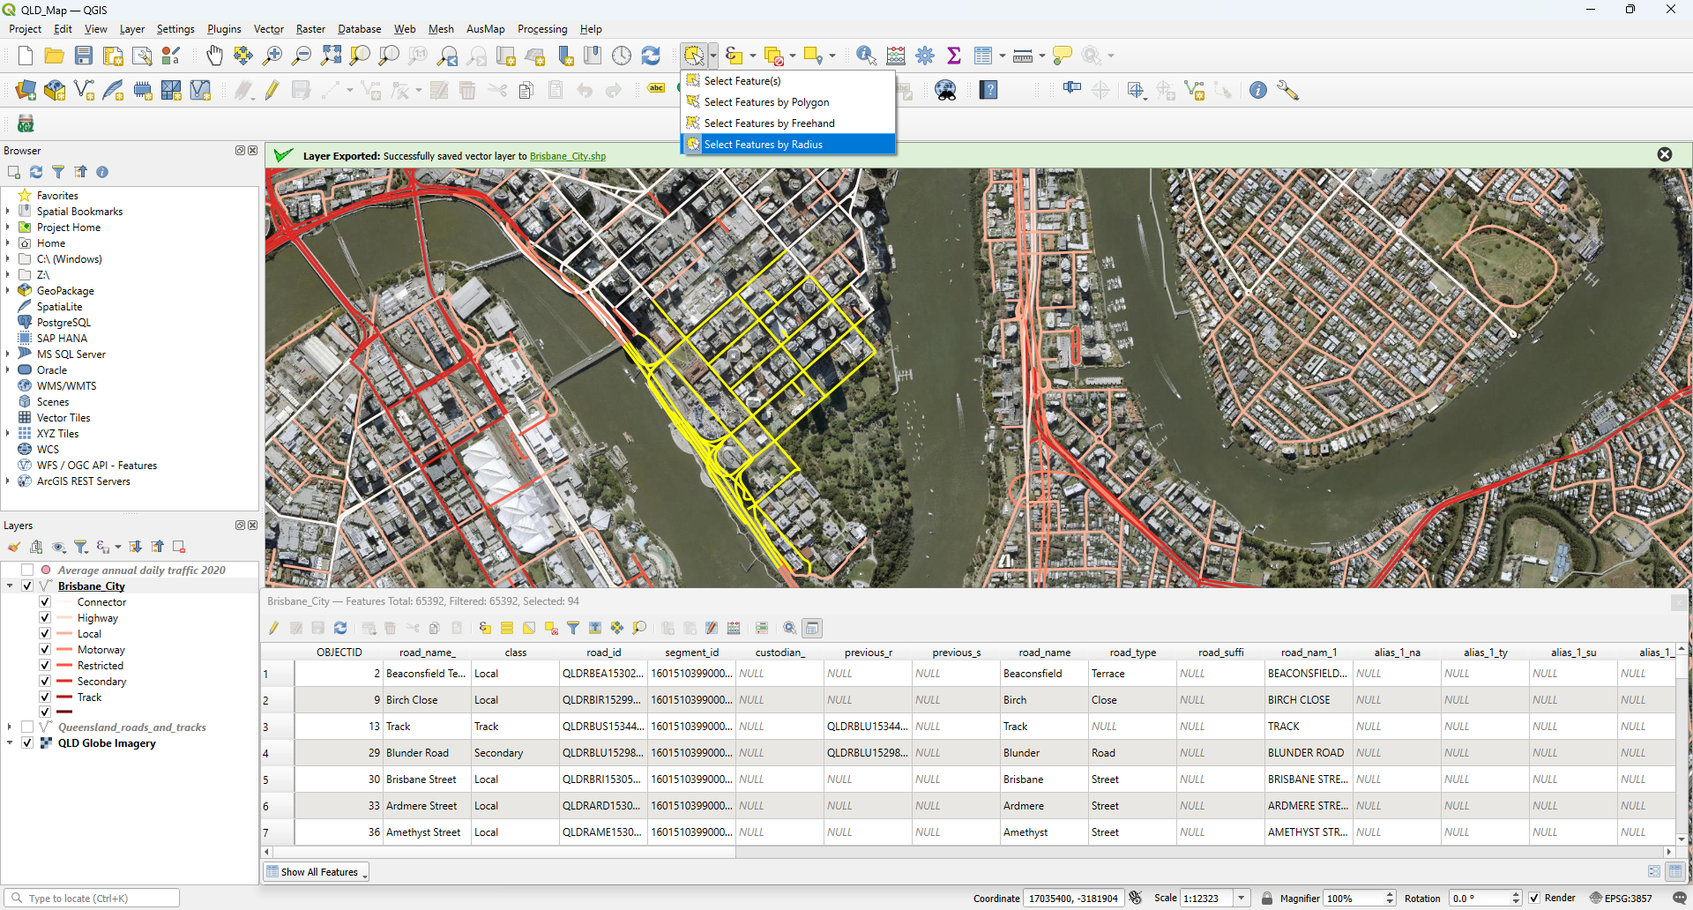
Selecting features from polyline based on select tool Toolbar > Select > Select Features by Radius > Click and drag in map to select

Slide 31
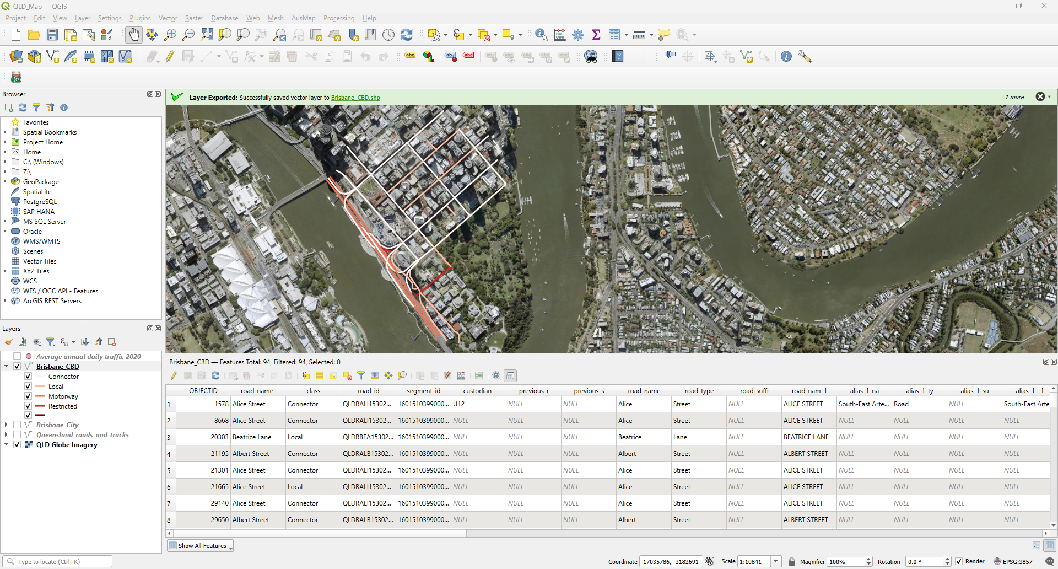
Save selected links as a separate layer Right click on layer after selection > Export > Make Layer from Selected Features

Slide 32
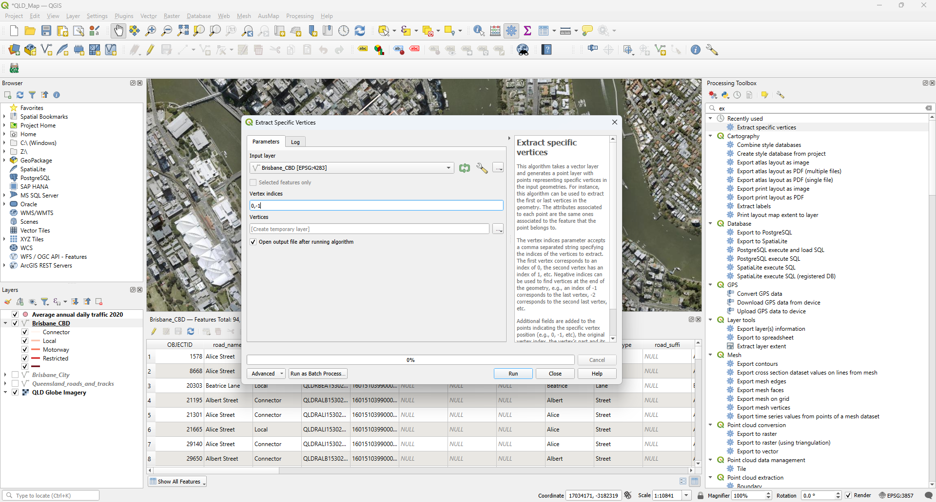
Find the Intersections and the links associated with
Find the Intersection - Processing > Toolbox > Search “Extract Specific Vertices”

Slide 33
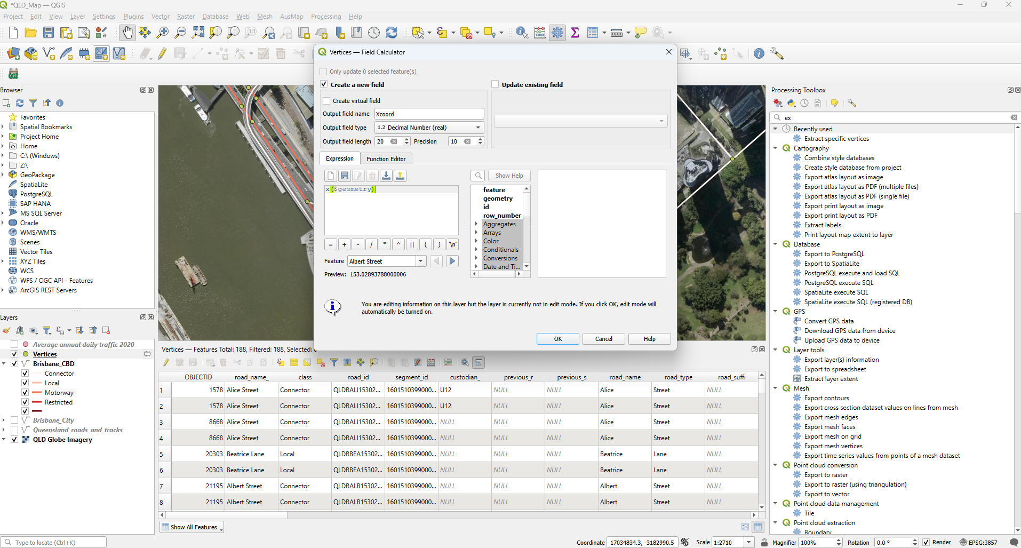

Find the Intersections and the links associated with
2. Open attribute table for “vertices” > Open Field Calculator >
Output field name : “Xcoord”; Expression : x($geometry)
Output field name : “Ycoord”; Expression : y($geometry)

Slide 34
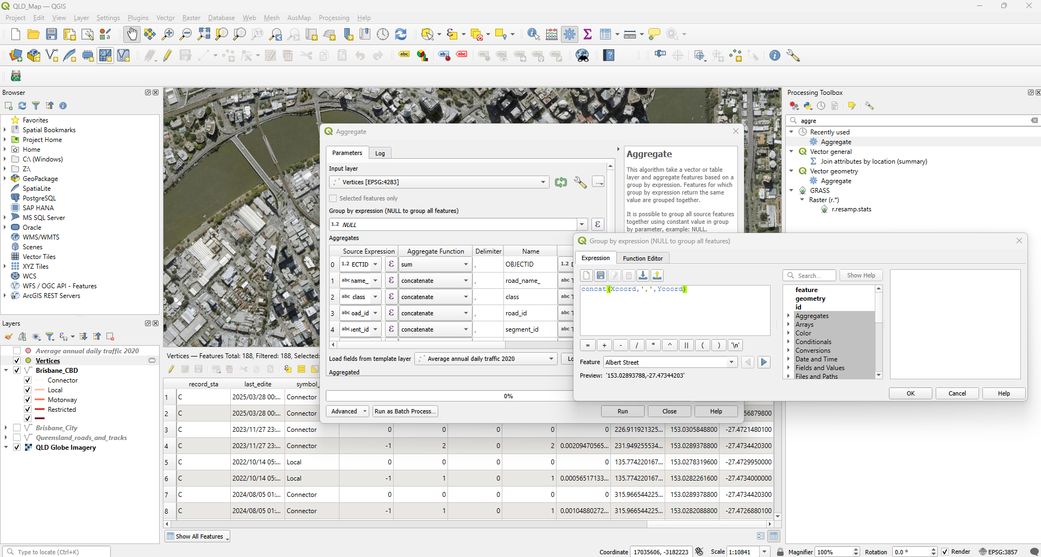
Find the Intersections and the links associated with
3. Processing Toolbox > Search “Vector geometry Aggregate”

Slide 35
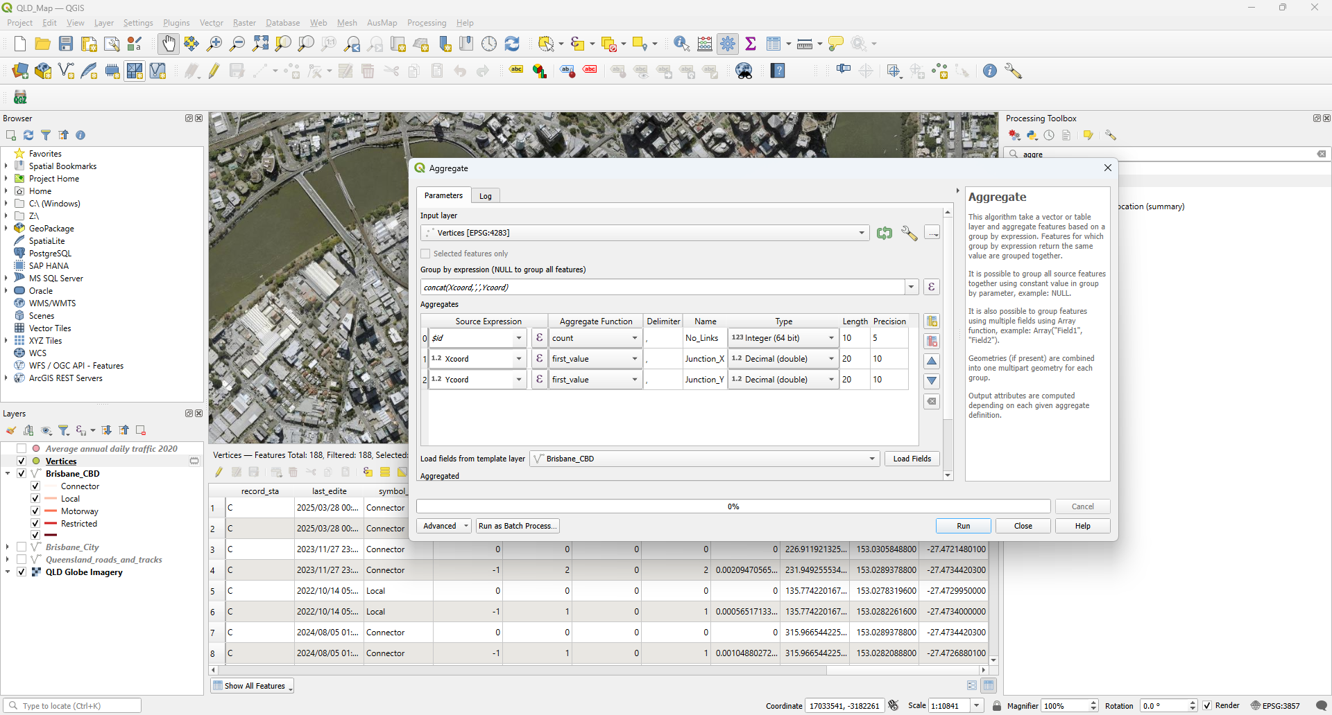
Find the Intersections and the links associated with
3. Processing Toolbox > Search “Vector geometry Aggregate”

Slide 36
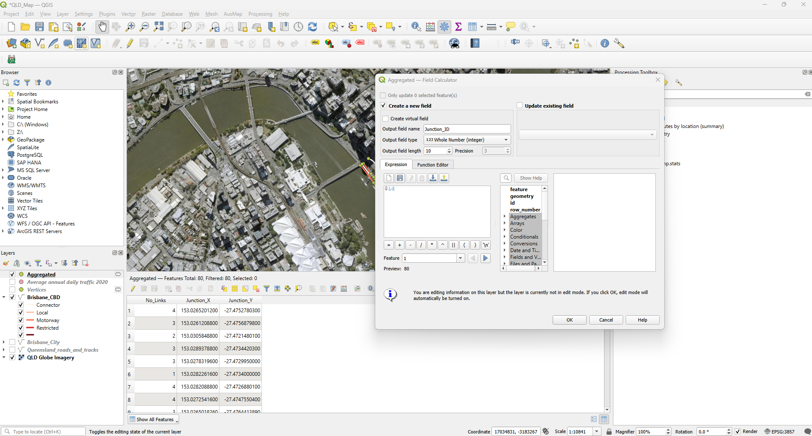

Find the Intersections and the links associated with
4. Add new field “JunctionID” to Aggregated Layer

Slide 37
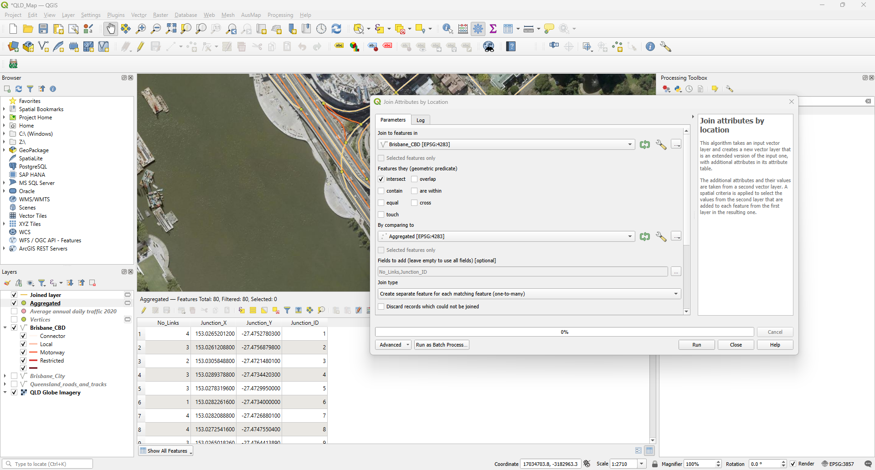

Find the Intersections and the links associated with
5. Join Attribute by location for “Aggregated” and “Brisbane_CBD” layers
Processing Toolbox > search for “Join Attributes by location”

Slide 38
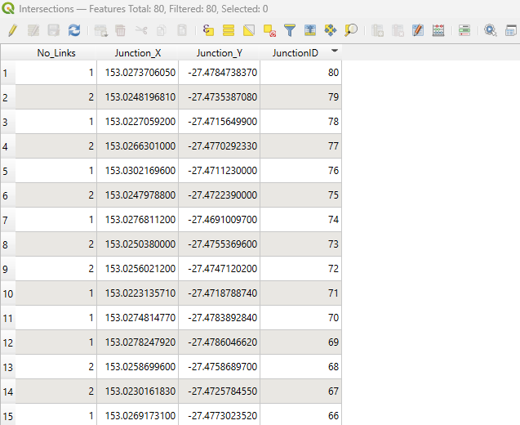
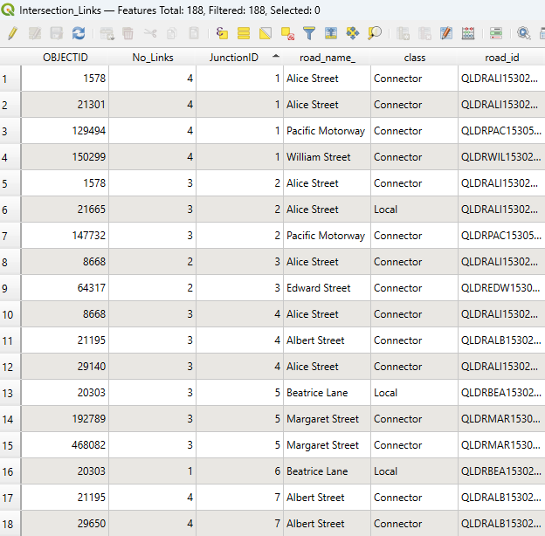
Spatial point data for the intersections.
Rename “Aggreated” layer to “Intersections”
Spatial point data for the links associated with the intersections.
Rename “Joined layer” layer to “Intersection_Links”

Slide 39
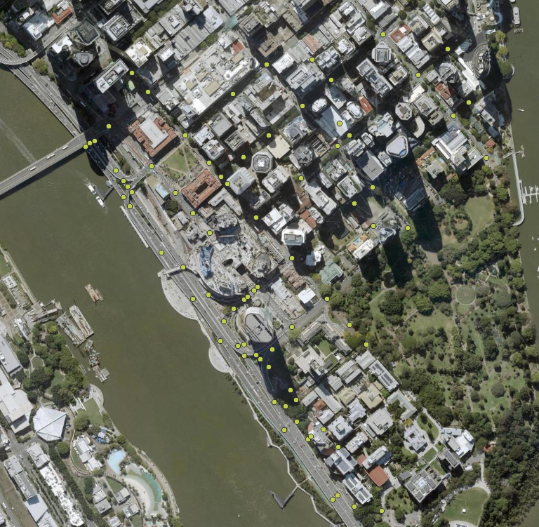
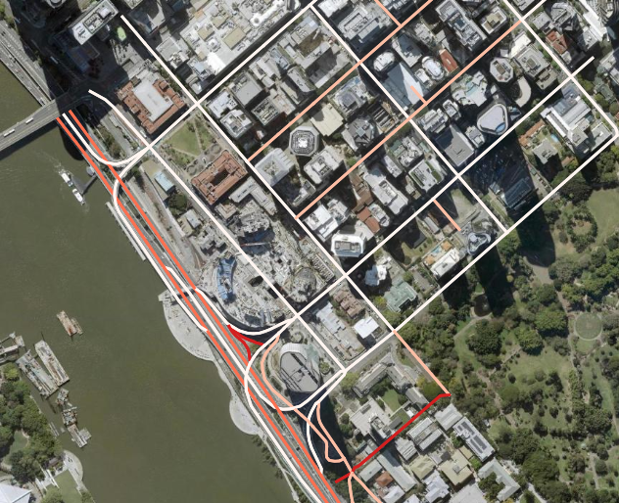
Spatial point data for the intersections.
Rename “Aggreated” layer to “Intersections”
Spatial point data for the links associated with the intersections.
Rename “Joined layer” layer to “Intersection_Links”

Slide 40
Task 2: For the selected “Goldcoast City” layer find intersections and their respective links
For the “Goldcoast City” layer, zoom in, use the radius selection tool, and export the selected features as a separate layer.
Then, find the intersection points and their associated links using “Extract Specific vertices”, “Vector Geometry Aggregate” and “Join Attribute by location”.
Obtain the two output layers for the intersection and the links associated with the intersections.

Slide 41
For a selected Intersection (node) identify the intersection type from reality (google maps) and store the information
In the attribute table “Toggle editing mode” then “Add field”. Set the name to “Junc_Type” and Type of Field to “Text” and set the length to “20”. Finally click on save edits.
From the “Intersections” attribute table select an intersection by id (JunctionID is 1) and click on the far-left side of the record. Notice that in the map now this record is now highlighted in bright yellow.
Navigate to the highlighted intersection on the map and right click on the intersection point in the map and select “Copy Coordinate” (EPSG:4326).
Open a web browser, go to “https://www.google.com/maps” and paste the copied coordinates in the search bar and go to the location. Open Street View using the icon in the bottom right corner of the google map.
From the street-view point of view gather relevant information for the intersection, here it would be the Intersection type and record it in the “Intersections” layer attribute table under “Junc_Type”.
If additional information needs to be recorded for the intersections, based on the information add a field to the “Intersections” layer and repeat steps from 2 to 5 until all intersections are populated.

Slide 42
For a selected Intersection (node) identify the intersection type from reality (google maps) and store the information
In the attribute table “Toggle editing mode” then “Add field”. Set the name to “Junc_Type” and Type of Field to “Text” and set the length to “20”. Finally click on “save edits”.
From the “Intersections” attribute table select an intersection by id (JunctionID is 1) and click on the far-left side of the record. Notice that in the map now this record is now highlighted in bright yellow.
Navigate to the highlighted intersection on the map and right click on the intersection point in the map and select “Copy Coordinate” (EPSG:4326).
Open a web browser, go to “https://www.google.com/maps” and paste the copied coordinates in the search bar and go to the location. Open Street View using the icon in the bottom right corner of the google map.
From the street-view point of view gather relevant information for the intersection, here it would be the Intersection type and record it in the “Intersections” layer attribute table under “Junc_Type”.
If additional information needs to be recorded for the intersections, based on the information add a field to the “Intersections” layer and repeat steps from 2 to 5 until all intersections are populated.

Slide 43
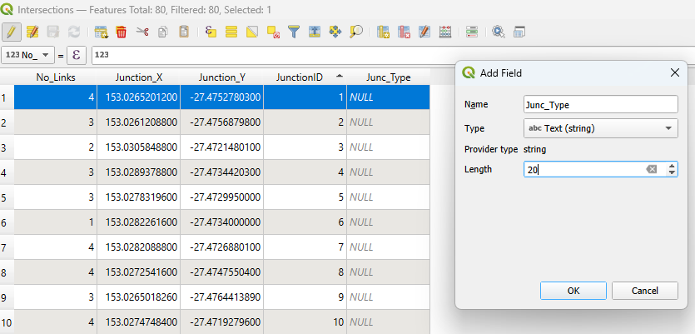
Add field “Junc_Type” > In “Name: Junc_Type” > set “Type: Text” > set “Length : 20” > “Save edits”
1
6
2
3
4
5

Slide 44
For a selected Intersection (node) identify the intersection type from reality (google maps) and store the information
In the attribute table “Toggle editing mode” then “Add field”. Set the name to “Junc_Type” and Type of Field to “Text” and set the length to “20”. Finally click on save edits.
From the “Intersections” attribute table select an intersection by id (JunctionID is 1) and click on the far-left side of the record. Notice that in the map now this record is now highlighted in bright yellow.
Navigate to the highlighted intersection on the map and right click on the intersection point in the map and select “Copy Coordinate” (EPSG:4326).
Open a web browser, go to “https://www.google.com/maps” and paste the copied coordinates in the search bar and go to the location. Open Street View using the icon in the bottom right corner of the google map.
From the street-view point of view gather relevant information for the intersection, here it would be the Intersection type and record it in the “Intersections” layer attribute table under “Junc_Type”.
If additional information needs to be recorded for the intersections, based on the information add a field to the “Intersections” layer and repeat steps from 2 to 5 until all intersections are populated.

Slide 45
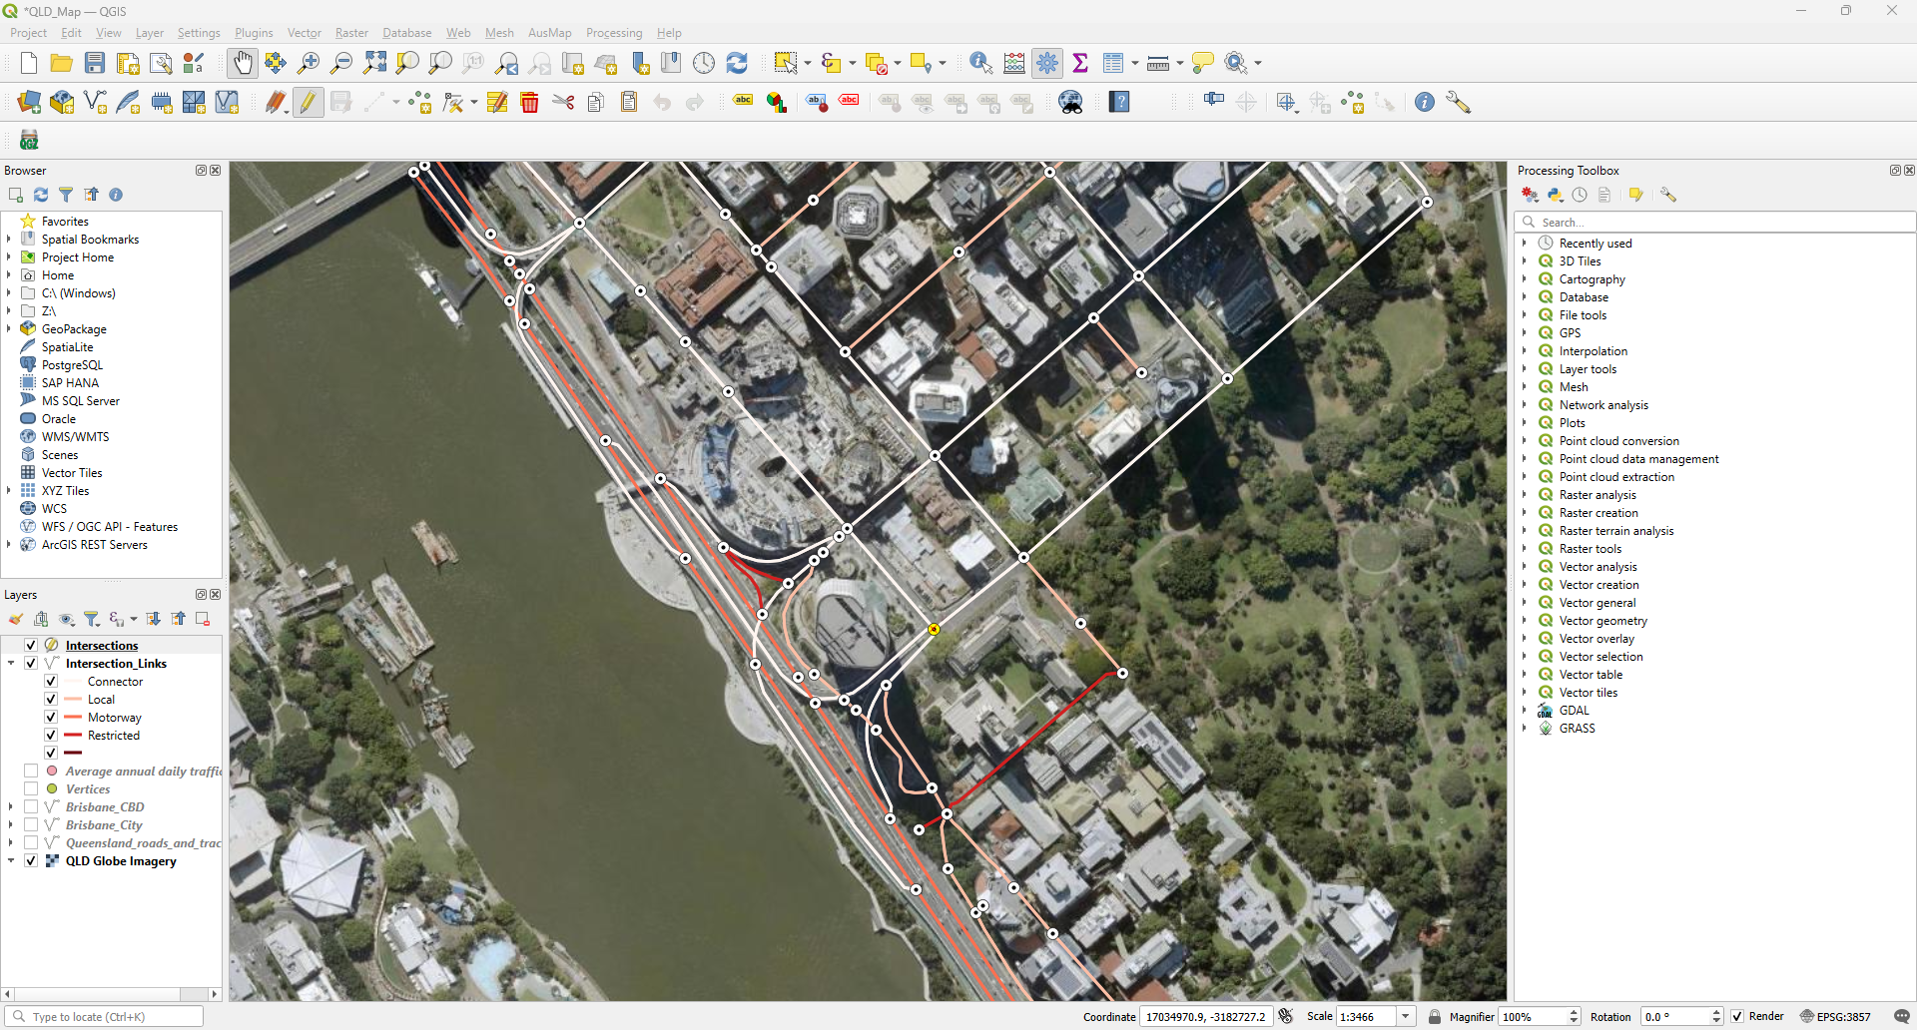
In “Intersections” attribute table select feature JUNC_ID is 1 and click on the far-left side of the record.

Slide 46
For a selected Intersection (node) identify the intersection type from reality (google maps) and store the information
In the attribute table “Toggle editing mode” then “Add field”. Set the name to “Junc_Type” and Type of Field to “Text” and set the length to “20”. Finally click on save edits.
From the “Intersections” attribute table select an intersection by id (JunctionID is 1) and click on the far-left side of the record. Notice that in the map now this record is now highlighted in bright yellow.
Navigate to the highlighted intersection on the map and right click on the intersection point in the map and select “Copy Coordinate” (EPSG:4326).
Open a web browser, go to “https://www.google.com/maps” and paste the copied coordinates in the search bar and go to the location. Open Street View using the icon in the bottom right corner of the google map.
From the street-view point of view gather relevant information for the intersection, here it would be the Intersection type and record it in the “Intersections” layer attribute table under “Junc_Type”.
If additional information needs to be recorded for the intersections, based on the information add a field to the “Intersections” layer and repeat steps from 2 to 5 until all intersections are populated.

Slide 47
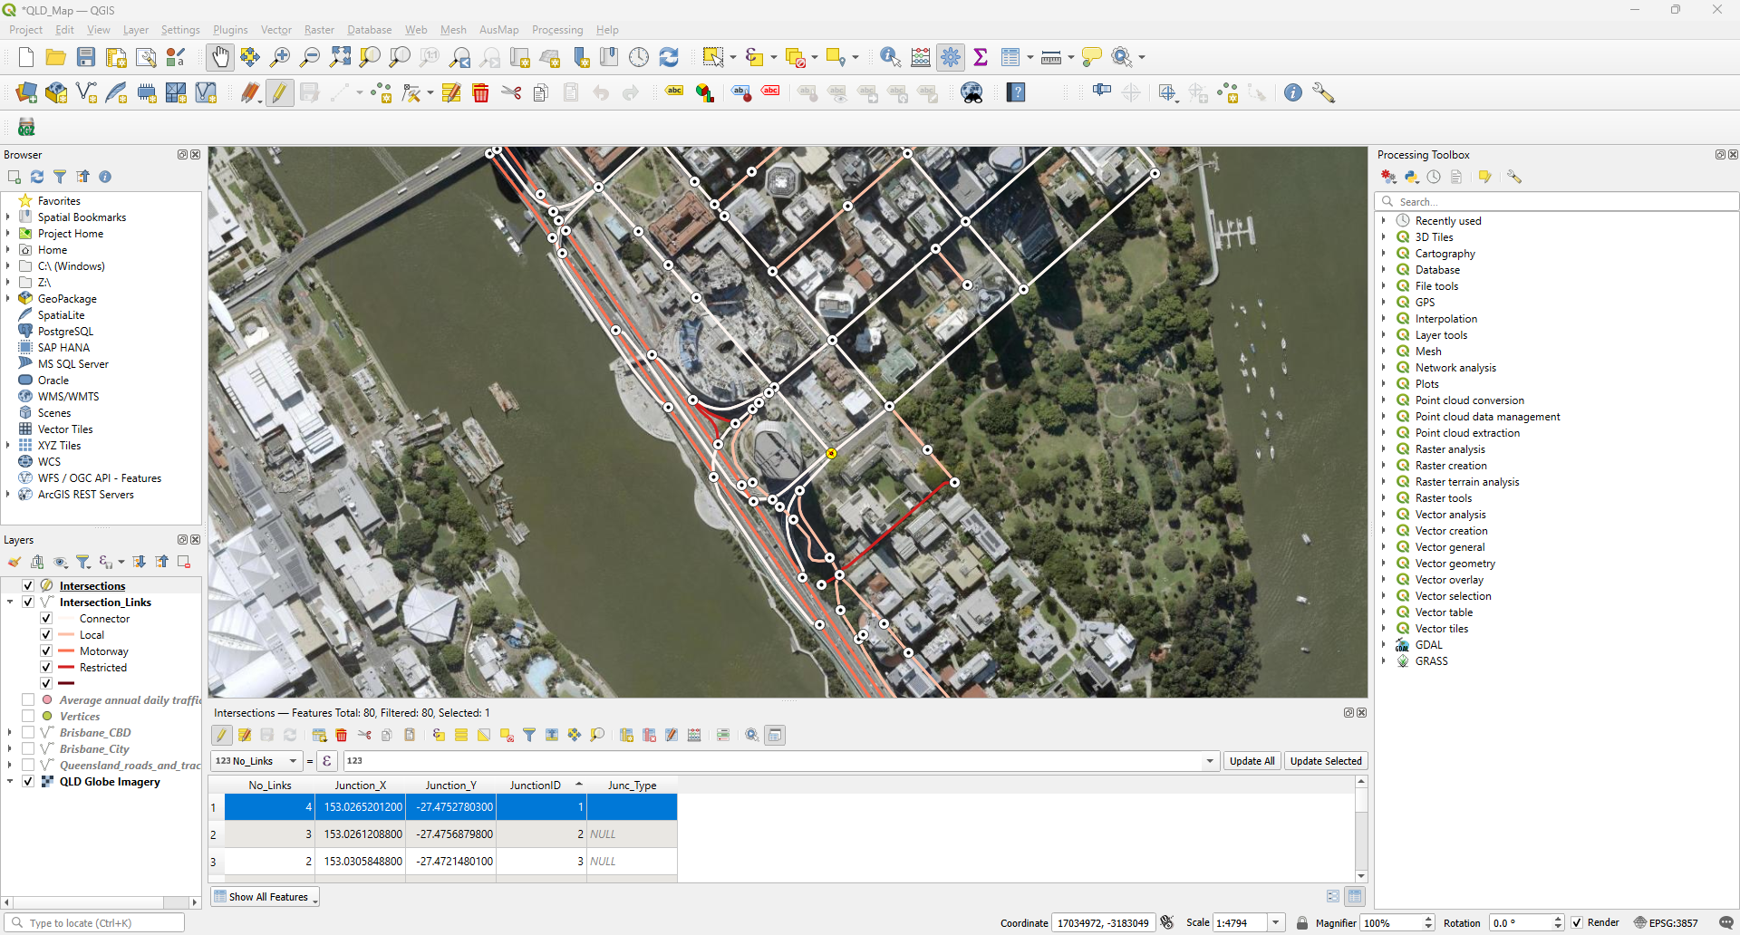
Go to the flashing intersection in the map and right click on the intersection point in the map and select “Copy Coordinates”.
The copied coordinates :
-27.4752798,
153.0265207

Slide 48
For a selected Intersection (node) identify the intersection type from reality (google maps) and store the information
In the attribute table “Toggle editing mode” then “Add field”. Set the name to “Junc_Type” and Type of Field to “Text” and set the length to “20”. Finally click on save edits.
From the “Intersections” attribute table select an intersection by id (JunctionID is 1) and click on the far-left side of the record. Notice that in the map now this record is now highlighted in bright yellow.
Navigate to the highlighted intersection on the map and right click on the intersection point in the map and select “Copy Coordinate” (EPSG:4326).
Open a web browser, go to “https://www.google.com/maps” and paste the copied coordinates in the search bar and go to the location. Open Street View using the icon in the bottom right corner of the google map.
From the street-view point of view gather relevant information for the intersection, here it would be the Intersection type and record it in the “Intersections” layer attribute table under “Junc_Type”.
If additional information needs to be recorded for the intersections, based on the information add a field to the “Intersections” layer and repeat steps from 2 to 5 until all intersections are populated.

Slide 49
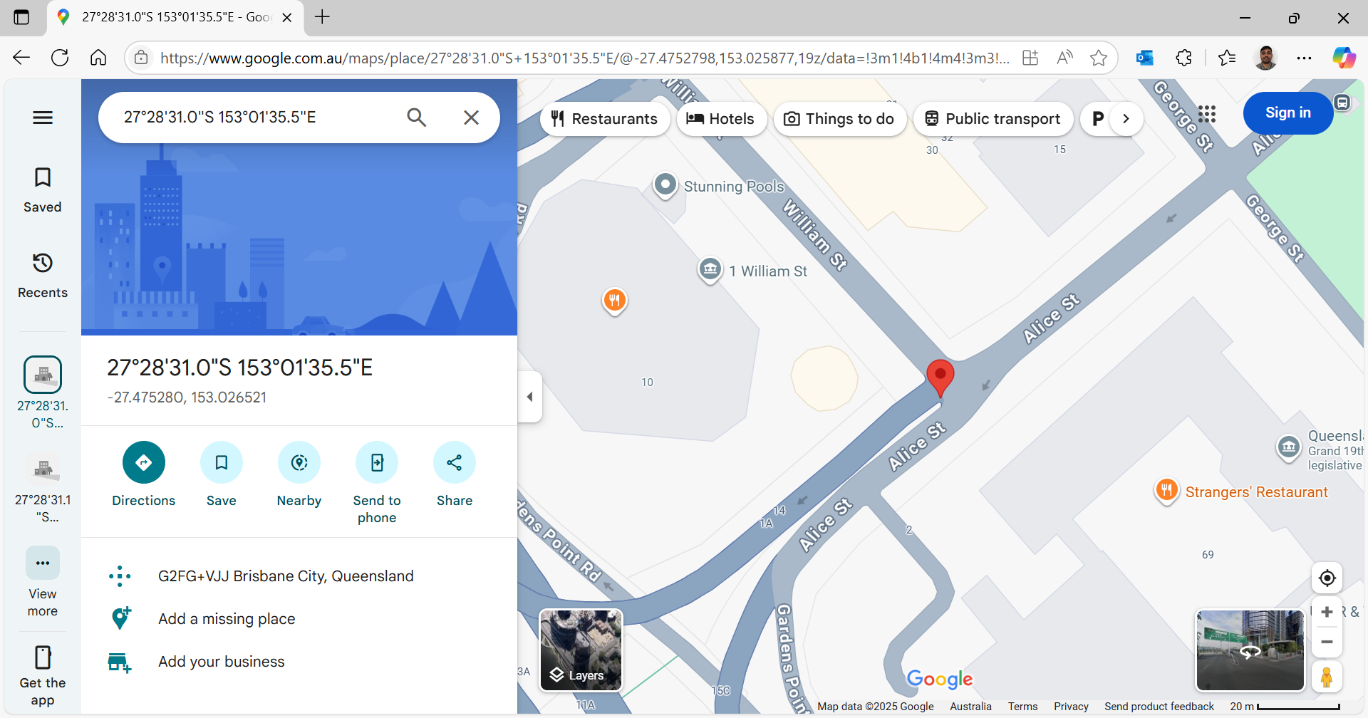
Open a web browser, go to google.maps and paste the copied coordinates in the search bar and select the street view window in the bottom right corner of the google map

Slide 50

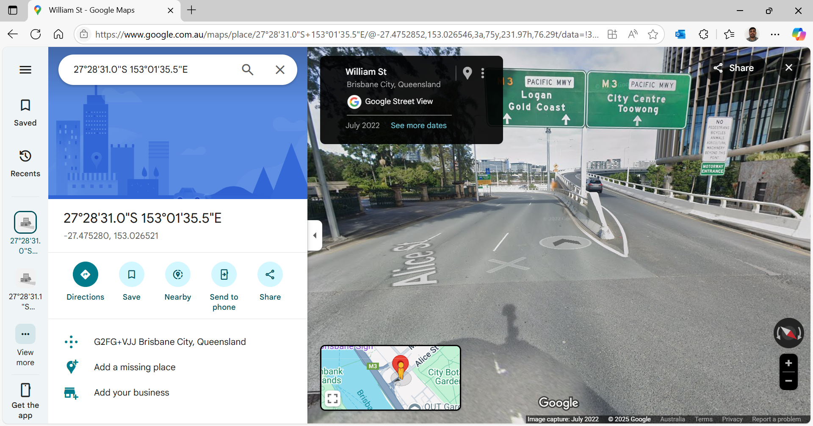
Open a web browser, go to google.maps and paste the copied coordinates in the search bar and select the street view window in the bottom right corner of the google map

Slide 51
Node Functional Type
DynusT
Record Type | Description
1 | No Control
2 | Yield Sign
3 | 4-Way Stop Sign
4 | Pre-Timed Signal Control
5 | Actuated Signal Control
6 | 2-Way Stop Sign

Slide 52
For a selected Intersection (node) identify the intersection type from reality (google maps) and store the information
In the attribute table “Toggle editing mode” then “Add field”. Set the name to “Junc_Type” and Type of Field to “Text” and set the length to “20”. Finally click on save edits.
From the “Intersections” attribute table select an intersection by id (JunctionID is 1) and click on the far-left side of the record. Notice that in the map now this record is now highlighted in bright yellow.
Navigate to the highlighted intersection on the map and right click on the intersection point in the map and select “Copy Coordinate” (EPSG:4326).
Open a web browser, go to “https://www.google.com/maps” and paste the copied coordinates in the search bar and go to the location. Open Street View using the icon in the bottom right corner of the google map.
From the street-view point of view gather relevant information for the intersection, here it would be the Intersection type and record it in the “Intersections” layer attribute table under “Junc_Type”.
If additional information needs to be recorded for the intersections, based on the information add a field to the “Intersections” layer and repeat steps from 2 to 5 until all intersections are populated.

Slide 53
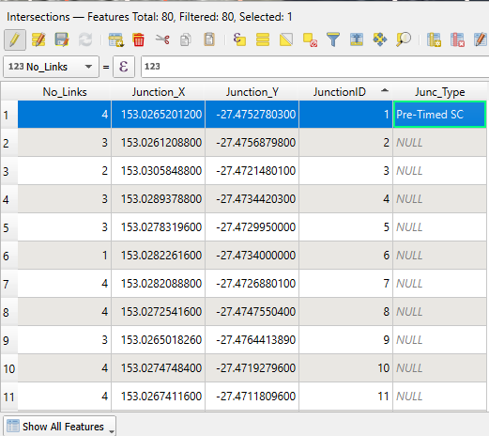
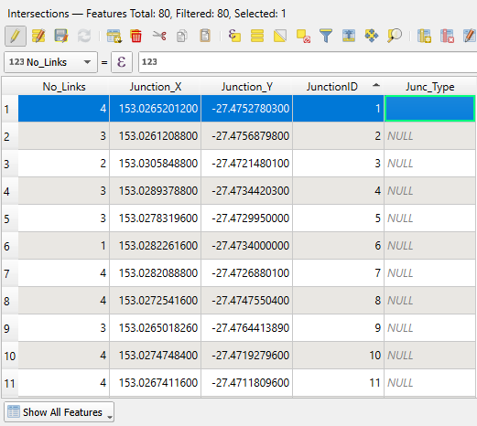
From the street view gather relevant information for the intersection and record it in the attribute table of “Intersections” layer Double click on cell adjacent to the relevant JunctionID is 1 under the field “Junc_Type” and type “” and save the attribute table and QGIS project (Ctrl + S)

Slide 54
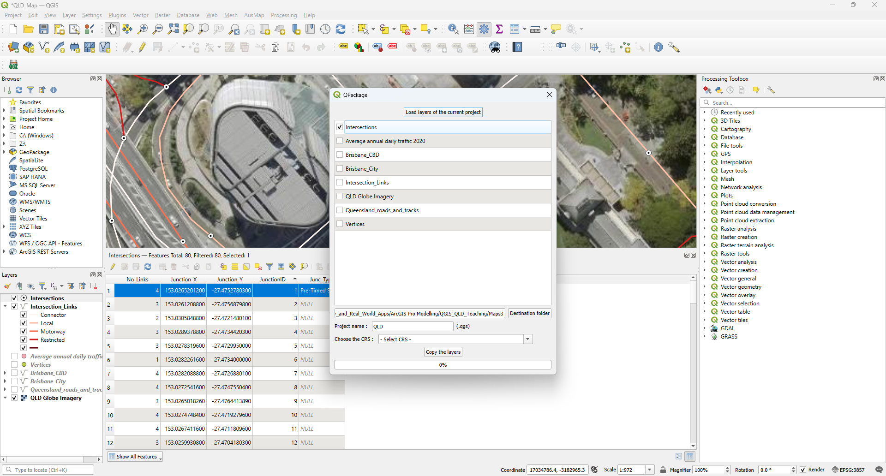
Save QGIS project and keep the spatial data
Plugins > Manage and Install Plugins > Search “QPackage” > install the plugin
Plugins > QPackage > Click on all relevant layers
Set Destination Folder “Maps” and click on “Copy the layers”

Slide 55
Data provided for the presentation and course
For this presentation ‘QSC_Extracted_Data’ contains Queensland roads and tracks data.
For this course ‘SEQ_Roads_Tracks_QGIS” is the QGIS project which contains spatial data for the links, intersections, links associated with intersections as separate layers named as
“SEQ_roads_tracks”
“SEQ_Intersection” and
“SEQ_Intersection_Links”,
respectively.

Slide 56
Thank You!

